Slide 1
Climate change and eco-anxiety

Slide 2
What is eco-anxiety?
How might different people experience the climate emergency?
Why is it important to communicate our emotions with others?
What are some terms that have been created to communicate how we feel about climate change?
How can I best support myself and others?
Notes:
STARTER: after introducing the theme of the day's lesson, ask students to close their eyes (by placing their heads on the table or similar) and listen to what the teacher will say. They are to raise their hand if they agree with the statements. They can choose to opt out by sitting silently with their eyes shut until the exercise is over.
EXAMPLE STATEMENTS:
I have felt anxious about climate change in the past
I currently feel anxious about climate change
I am hopeful about the future of the planet
I am worried about the future of the planet
Decision-makers are doing enough to tackle climate change
I wish there was more that I could do to tackle climate change

Slide 3
Eco-anxiety
Eco-guilt
Radical Hope
Eutierria
Tierratrauma
Solastalgia
Feelings of helplessness, anger, insomnia, panic and guilt toward the climate and ecological crisis. Persistent and intrusive worries about the future of the Earth
The regret of feeling you can / could have done more
Characterised by experiencing (first-hand or otherwise) the destruction of the natural environment. This could be through oil spills, hurricanes, floods and so on
Accepting a tragic destruction of their way of life as a means to imagining a new future
A feeling of oneness with Earth
The distress caused by the loss of a comforting place
Notes:
Eco-anxiety: feelings of helplessness, anger, insomnia, panic and guilt toward the climate and ecological crisis. Persistent and intrusive worries about the future of the Earth
Solastalgia: The distress caused by the loss of a comforting place
Eutierria: A feeling of oneness with Earth
Eco-guilt: The Regret Of feeling You Can / Could Have Done More
Tierratrauma: characterised by experiencing (first-hand or otherwise) the destruction of the natural environment. This could be through oil spills, hurricanes, floods and so on. Tierratrauma is thought of as being more intense and visceral than solastalgia
Radical Hope: accepting a tragic destruction of their way of life as a means to imagining a new future

Slide 4
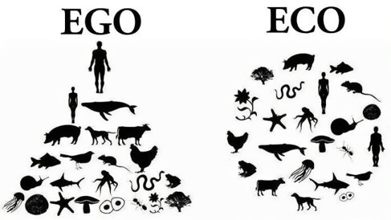
Think-Pair-Share: Why are our emotions affected by the state of the planet?

Slide 5
“Son of man, prophesy against the shepherds of Israel; prophesy and say to them: ‘This is what the Sovereign Lord says: Woe to you shepherds of Israel who only take care of yourselves! Should not shepherds take care of the flock? You eat the curds, clothe yourselves with the wool and slaughter the choice animals, but you do not take care of the flock. — Ezekiel 34:2-3 (NIV)
Then the Lord God formed a man from the dust of the ground and breathed into his nostrils the breath of life, and the man became a living being. (Genesis 2:7)
Then God said, ‘Let us make man in our image, after our likeness. And let them have dominion over the fish of the sea and over the birds of the heavens and over the livestock and over all the earth and over every creeping thing that creeps on the earth.' (Genesis 1:26)

Slide 6
“And We made the sky a protected ceiling, but they, from its signs, are turning away.” Quran, 21:32
“…And do not commit abuse on the earth, spreading corruption.” Quran, 2:60

Slide 7
How do the images make you feel? How might the images make others feel?
How does the image make you feel | How might the image make others feel? | Do you have any questions about the image?
Happy | Locals | Where was it taken?
Sad | Those from a country that contributes more to climate change | Who lives there?
Worried | World leaders | When was it taken?
Hopeful | Theists
Peaceful | Older and past generations | What can be done to improve it?
Angry | Future generations | What caused the event captured in the image?
Confused | Animals | What happened next?
... | ... | ...

Slide 8
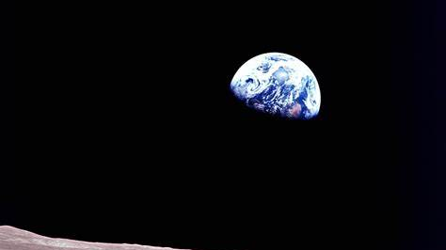

Slide 9
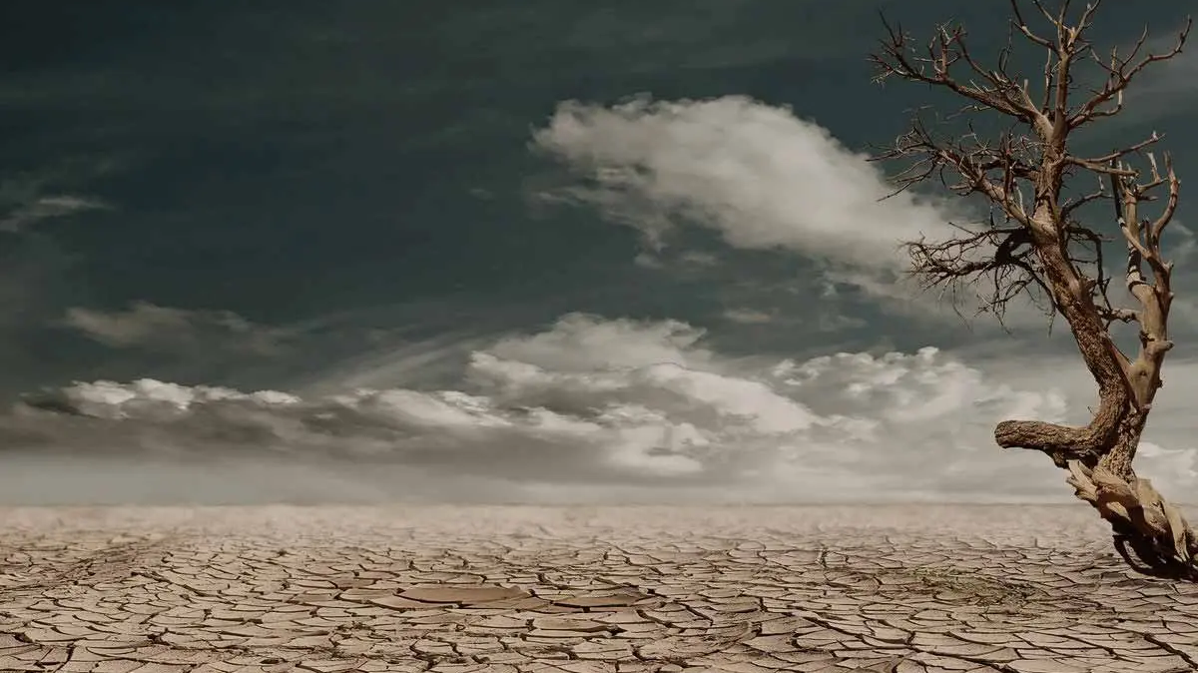

Slide 10
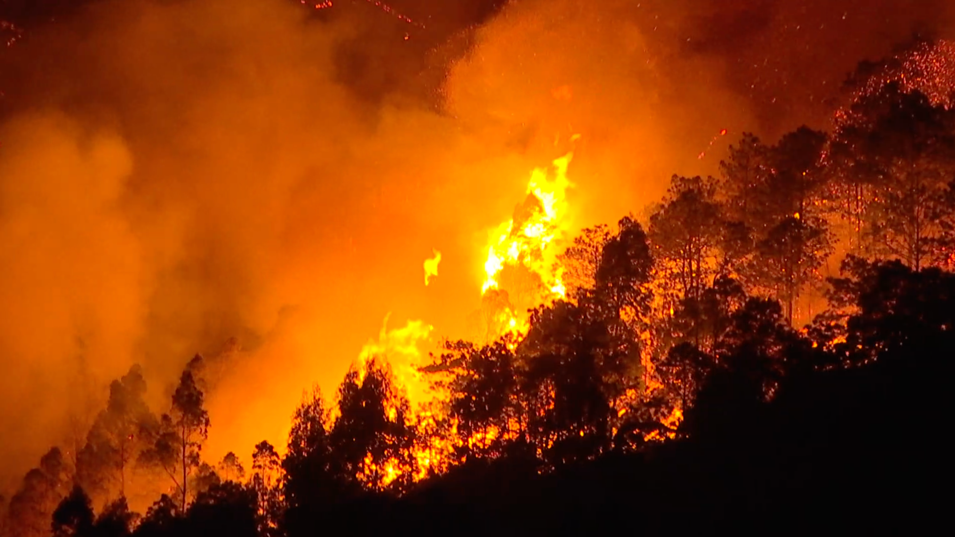

Slide 11
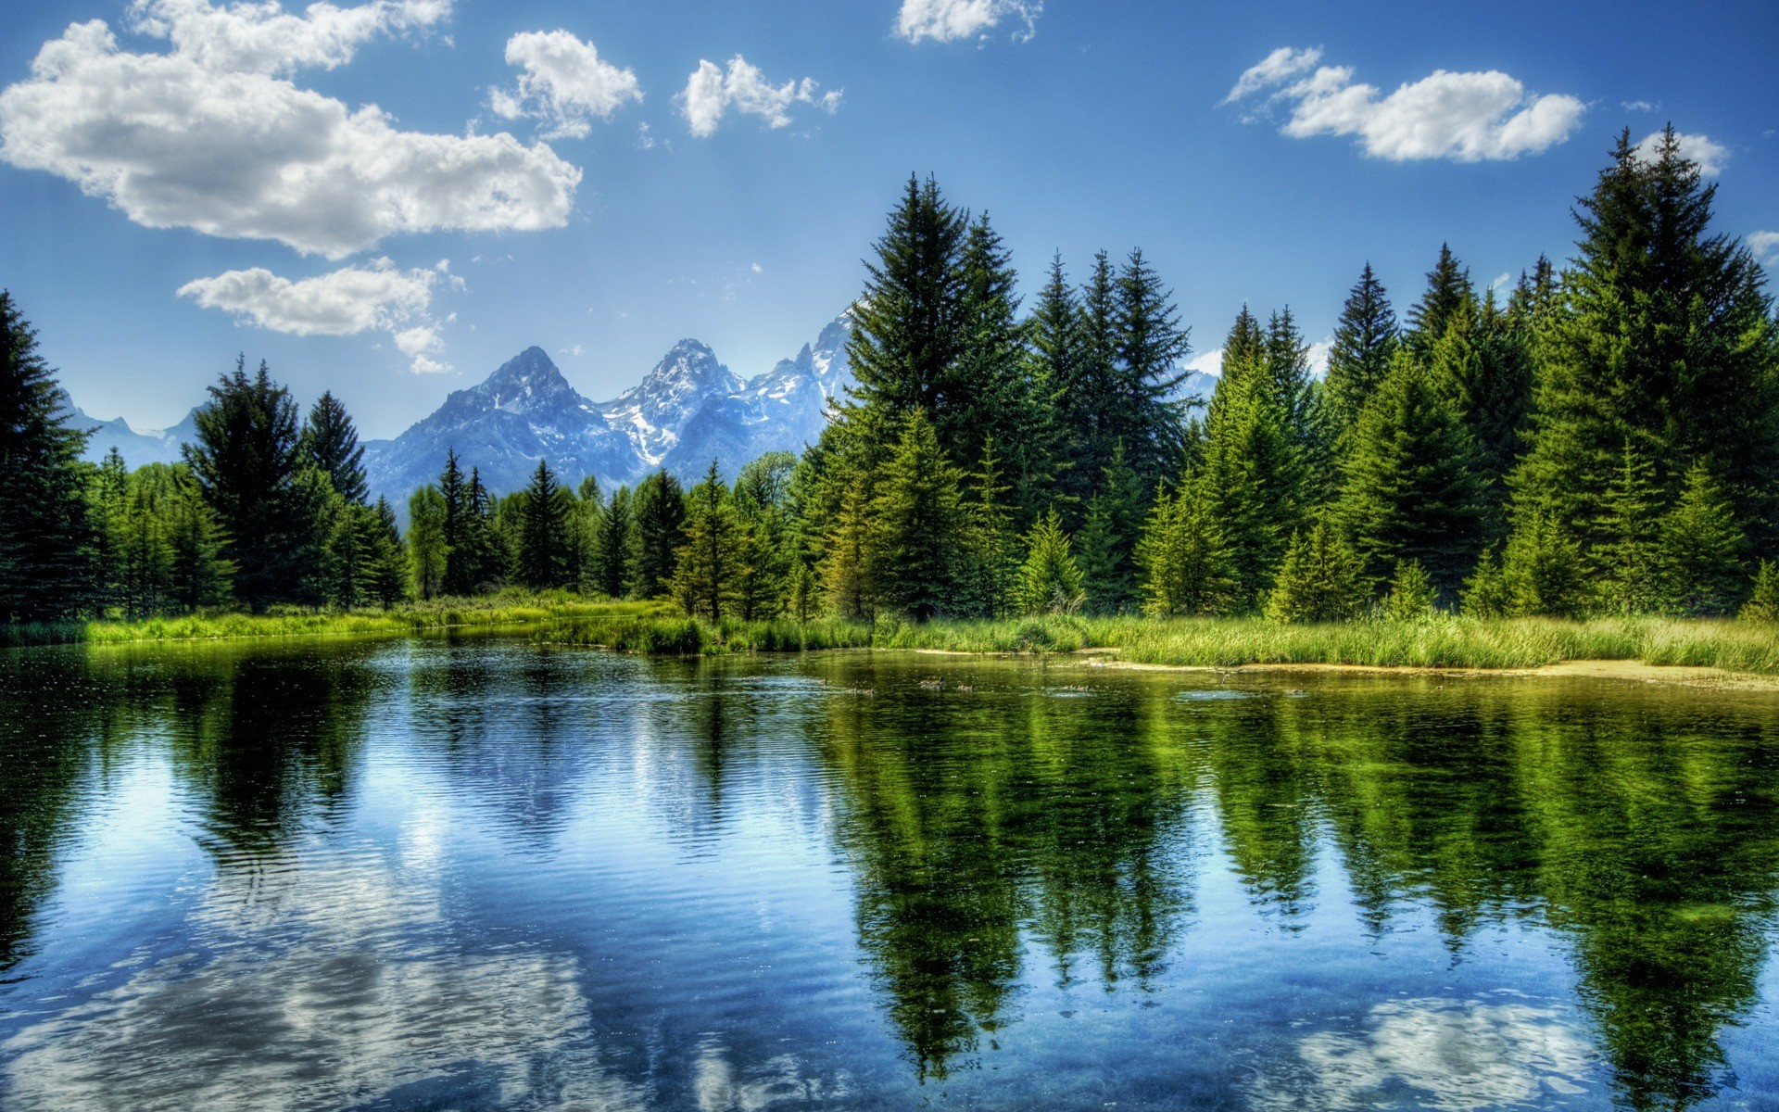

Slide 12
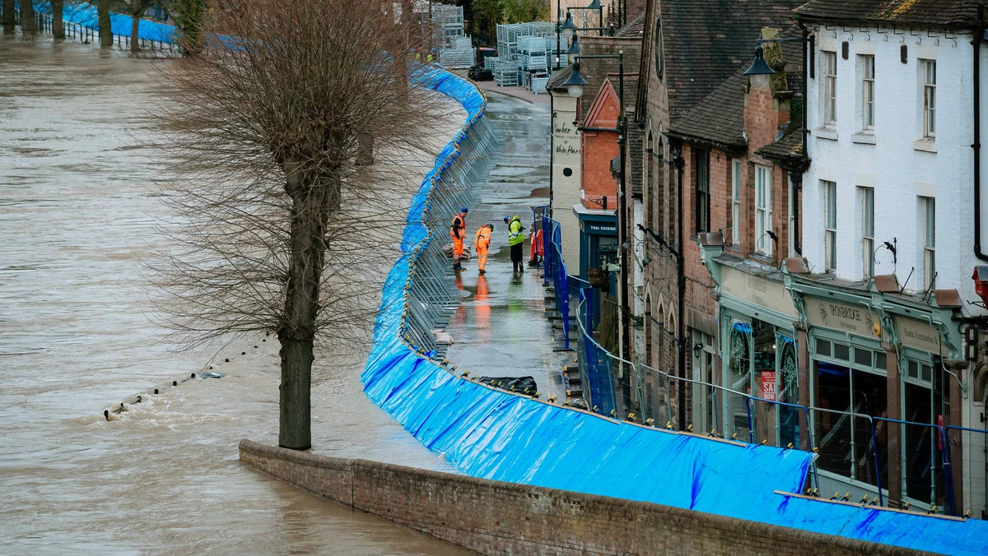

Slide 13
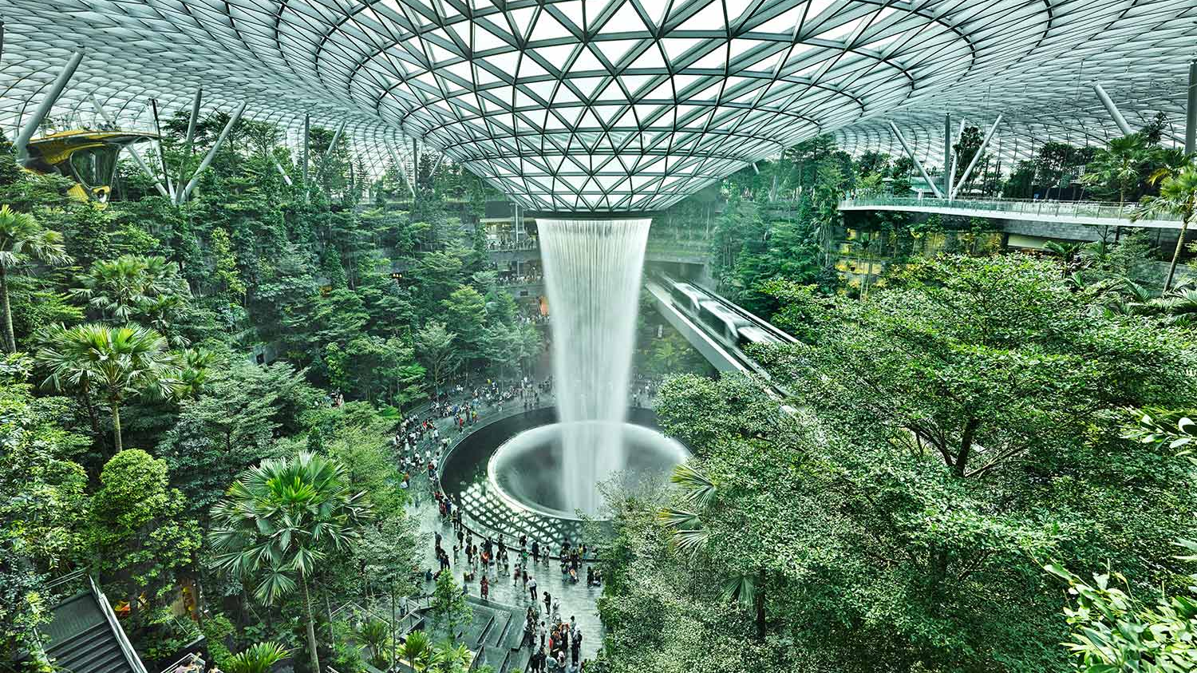

Slide 14
I need advice about my climate emotions!

Slide 15
