Slide 1
Biodiversity

Slide 2
What are we learning today?
What is biodiversity?
How many biomes does the world have?
Why is protecting biodiversity important?
What is a trophic cascade, and what causes one?
How can we re-evaluate our relationship with nature?

Slide 3
Biodiversity

Slide 4
Biodiversity
'Bio' is short for 'biological'. Biology relates to all living things
Diversity relates to how much something is composed of different elements: humans and nonhumans

Slide 5
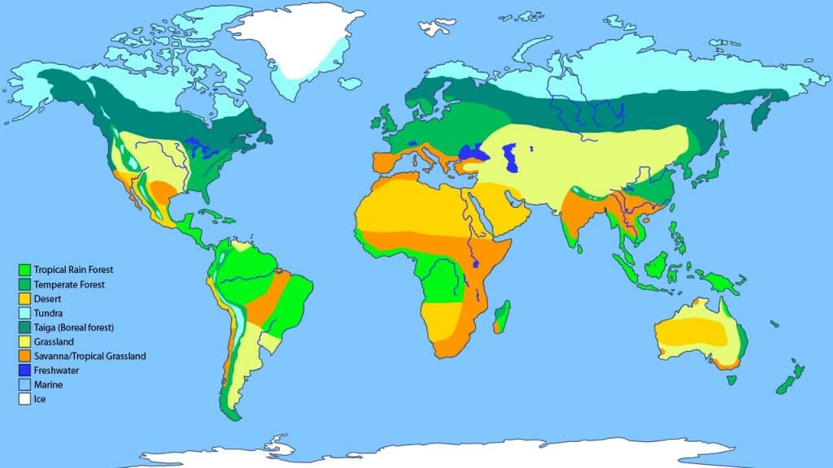
The world's biomes
What animals might be present in each of the world's biomes?

Slide 6
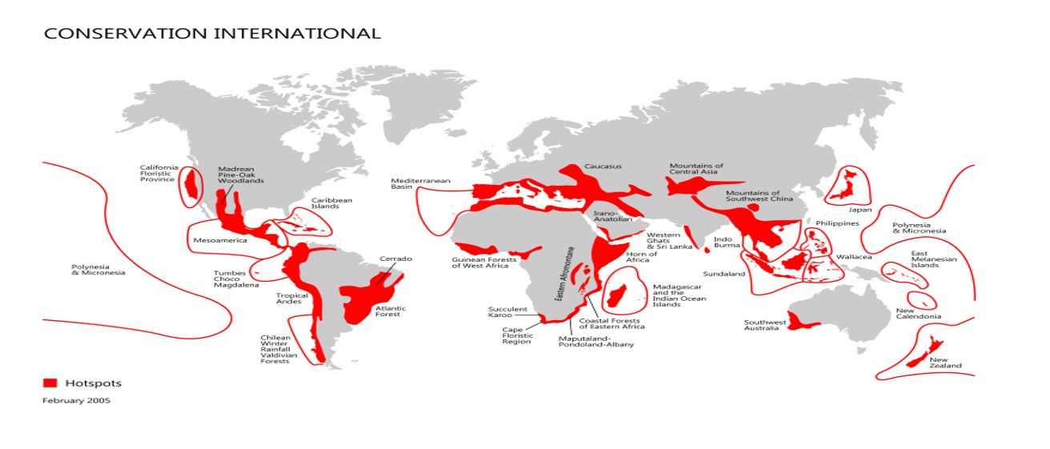
The world's biodiversity hotspots
Endemic species can be found in hotspots – a hotspot must have at least 1,500 species of endemic plants
Hotspots must also have lost 70% of their original area

Slide 7
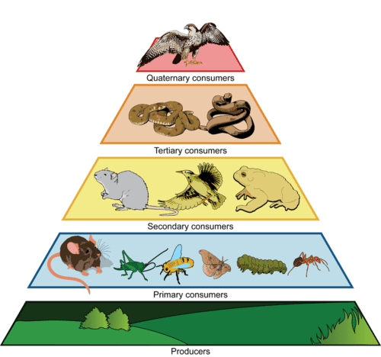
Understanding trophic levels

Slide 8
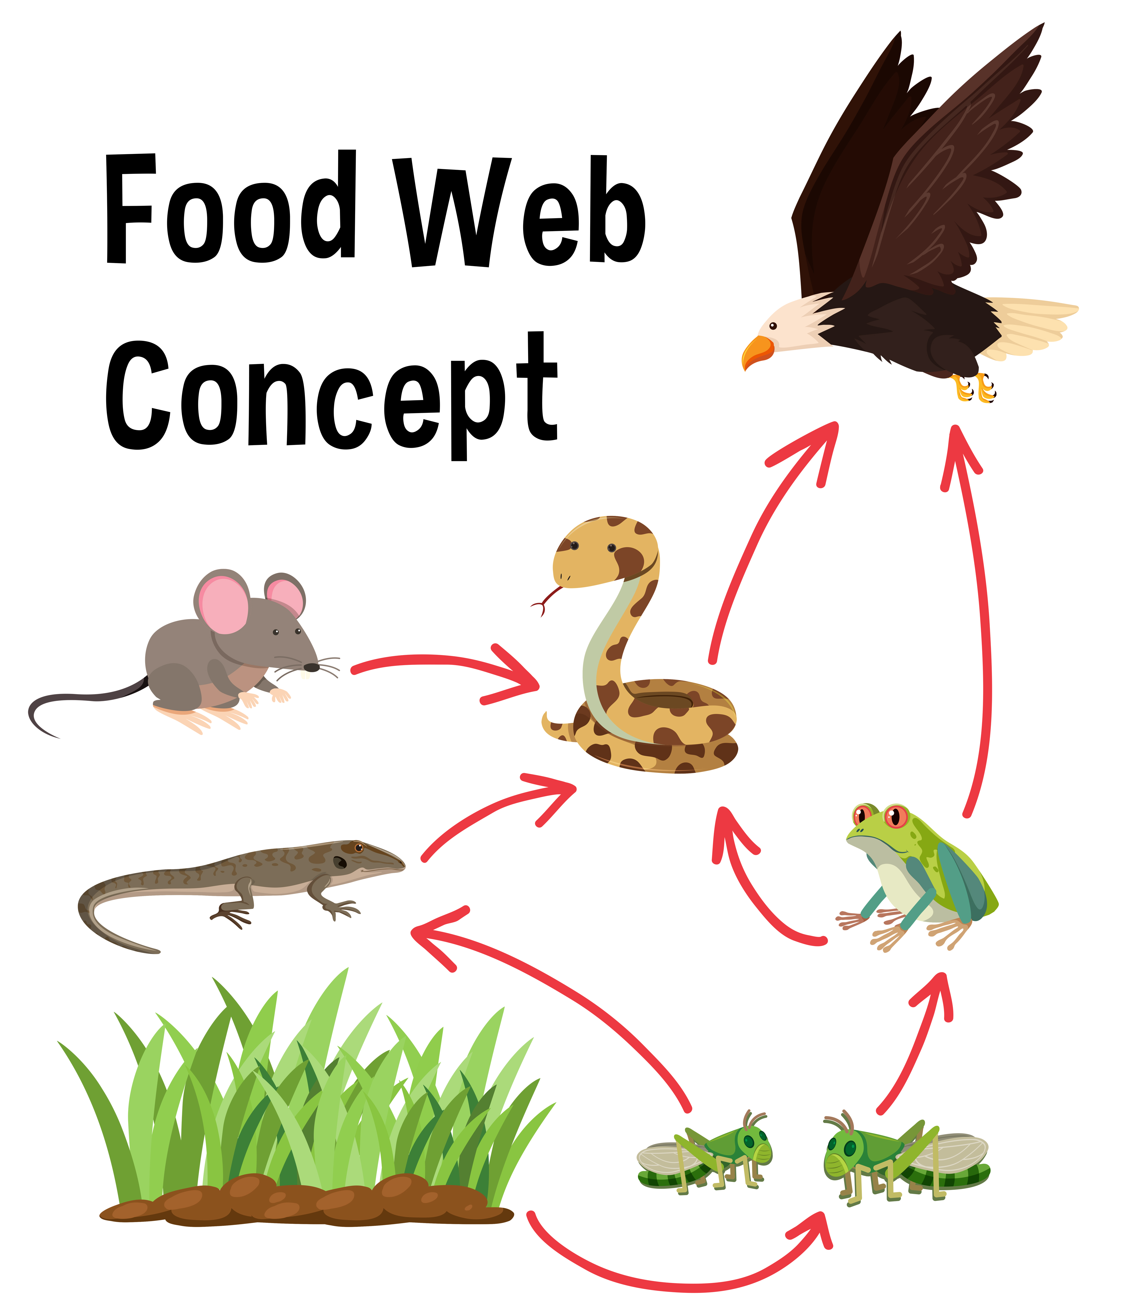
Everything in nature is interconnected

Slide 9
What happens when we lose a species?

Slide 10
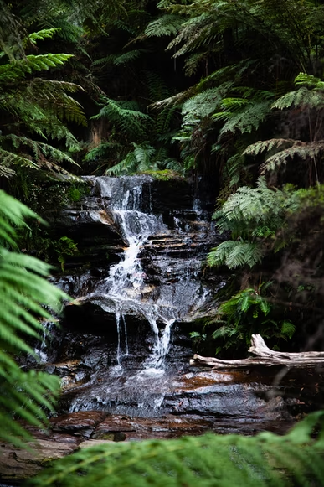
This is called a trophic cascade

Slide 12
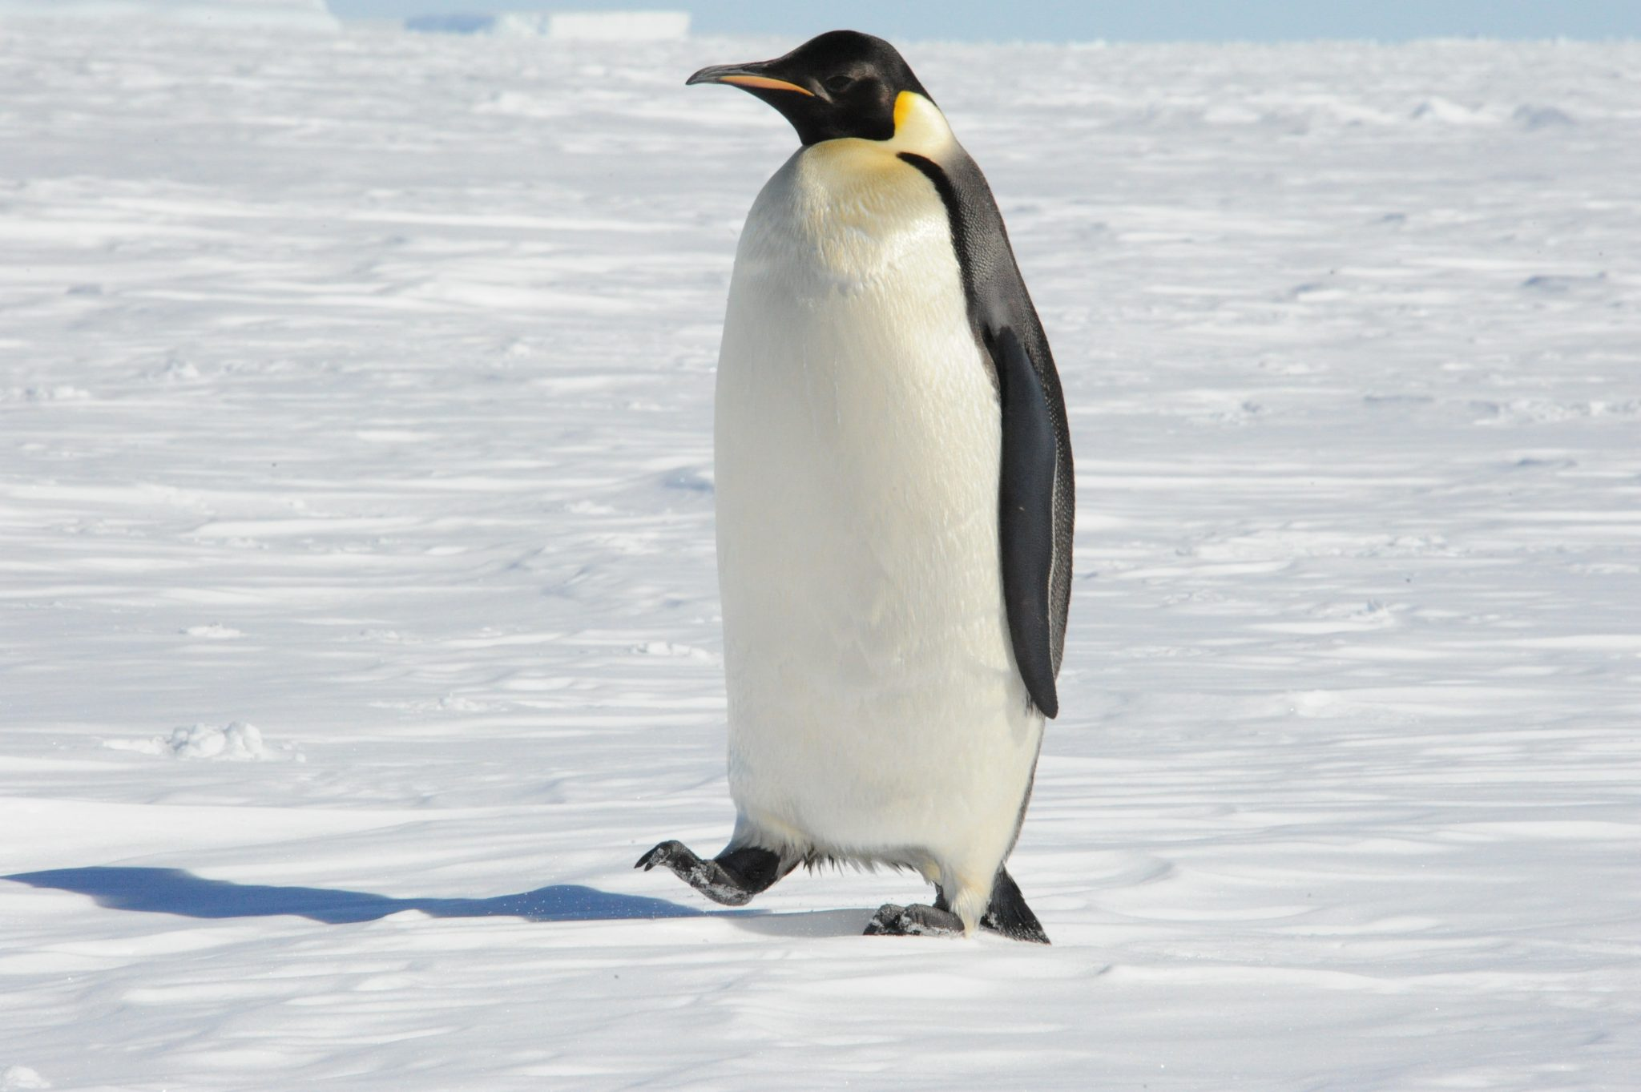
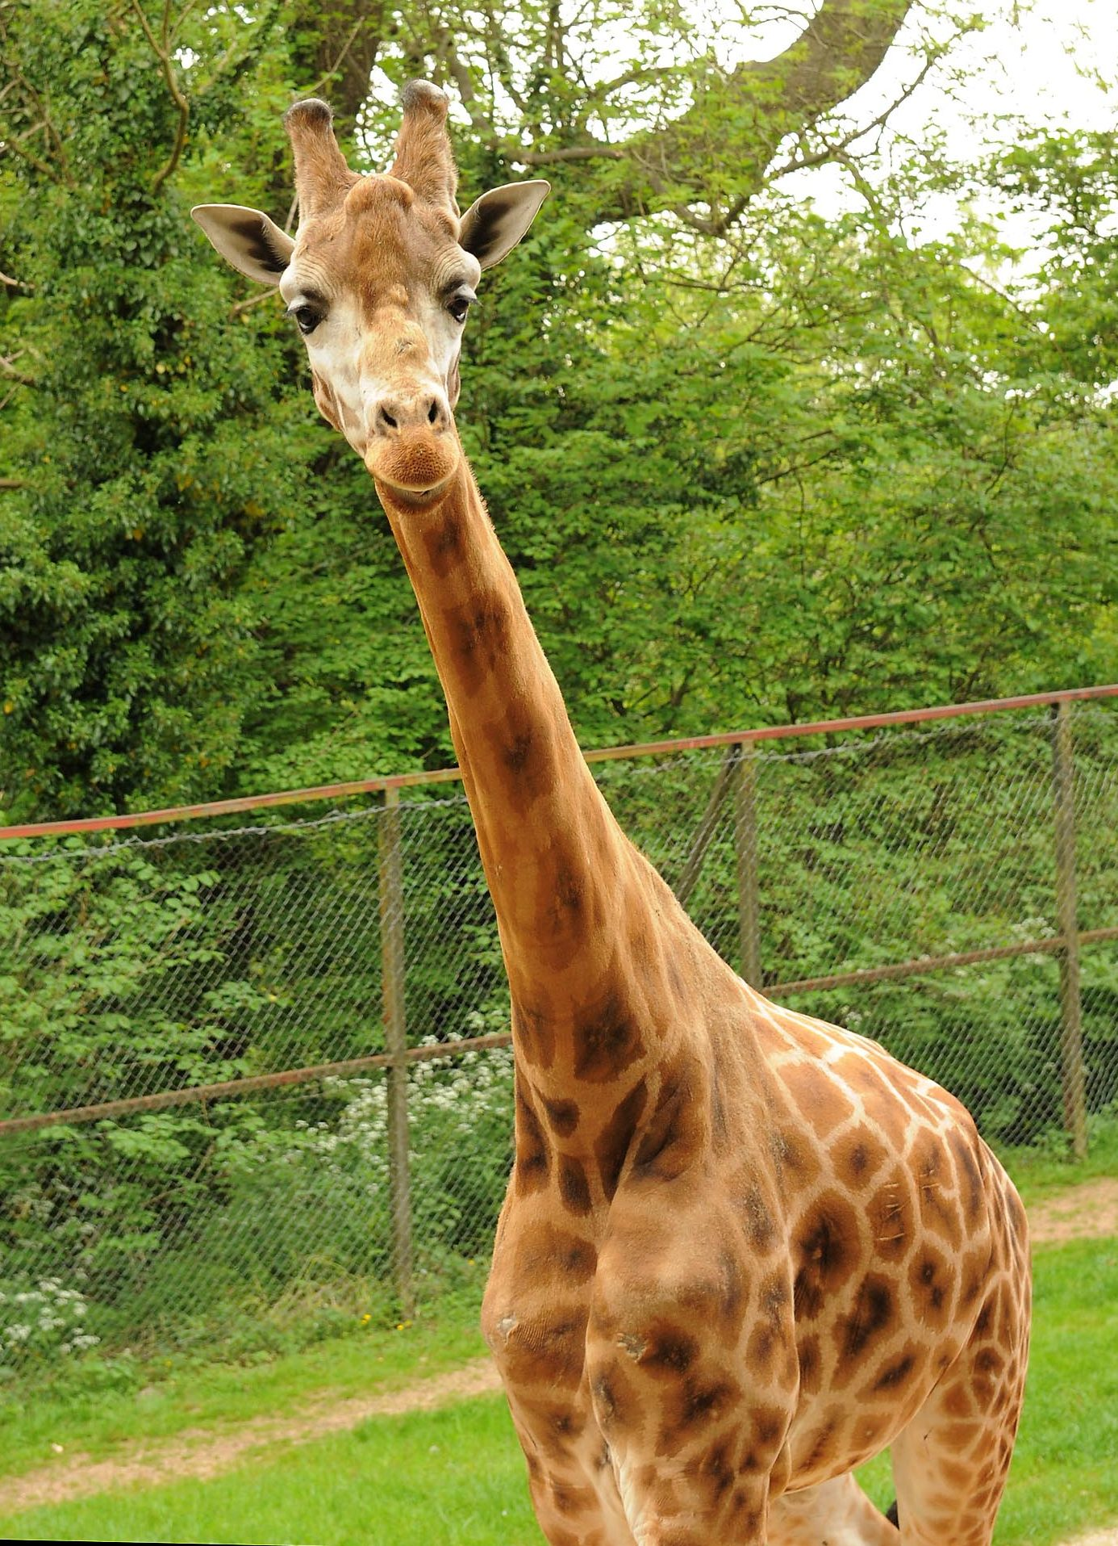
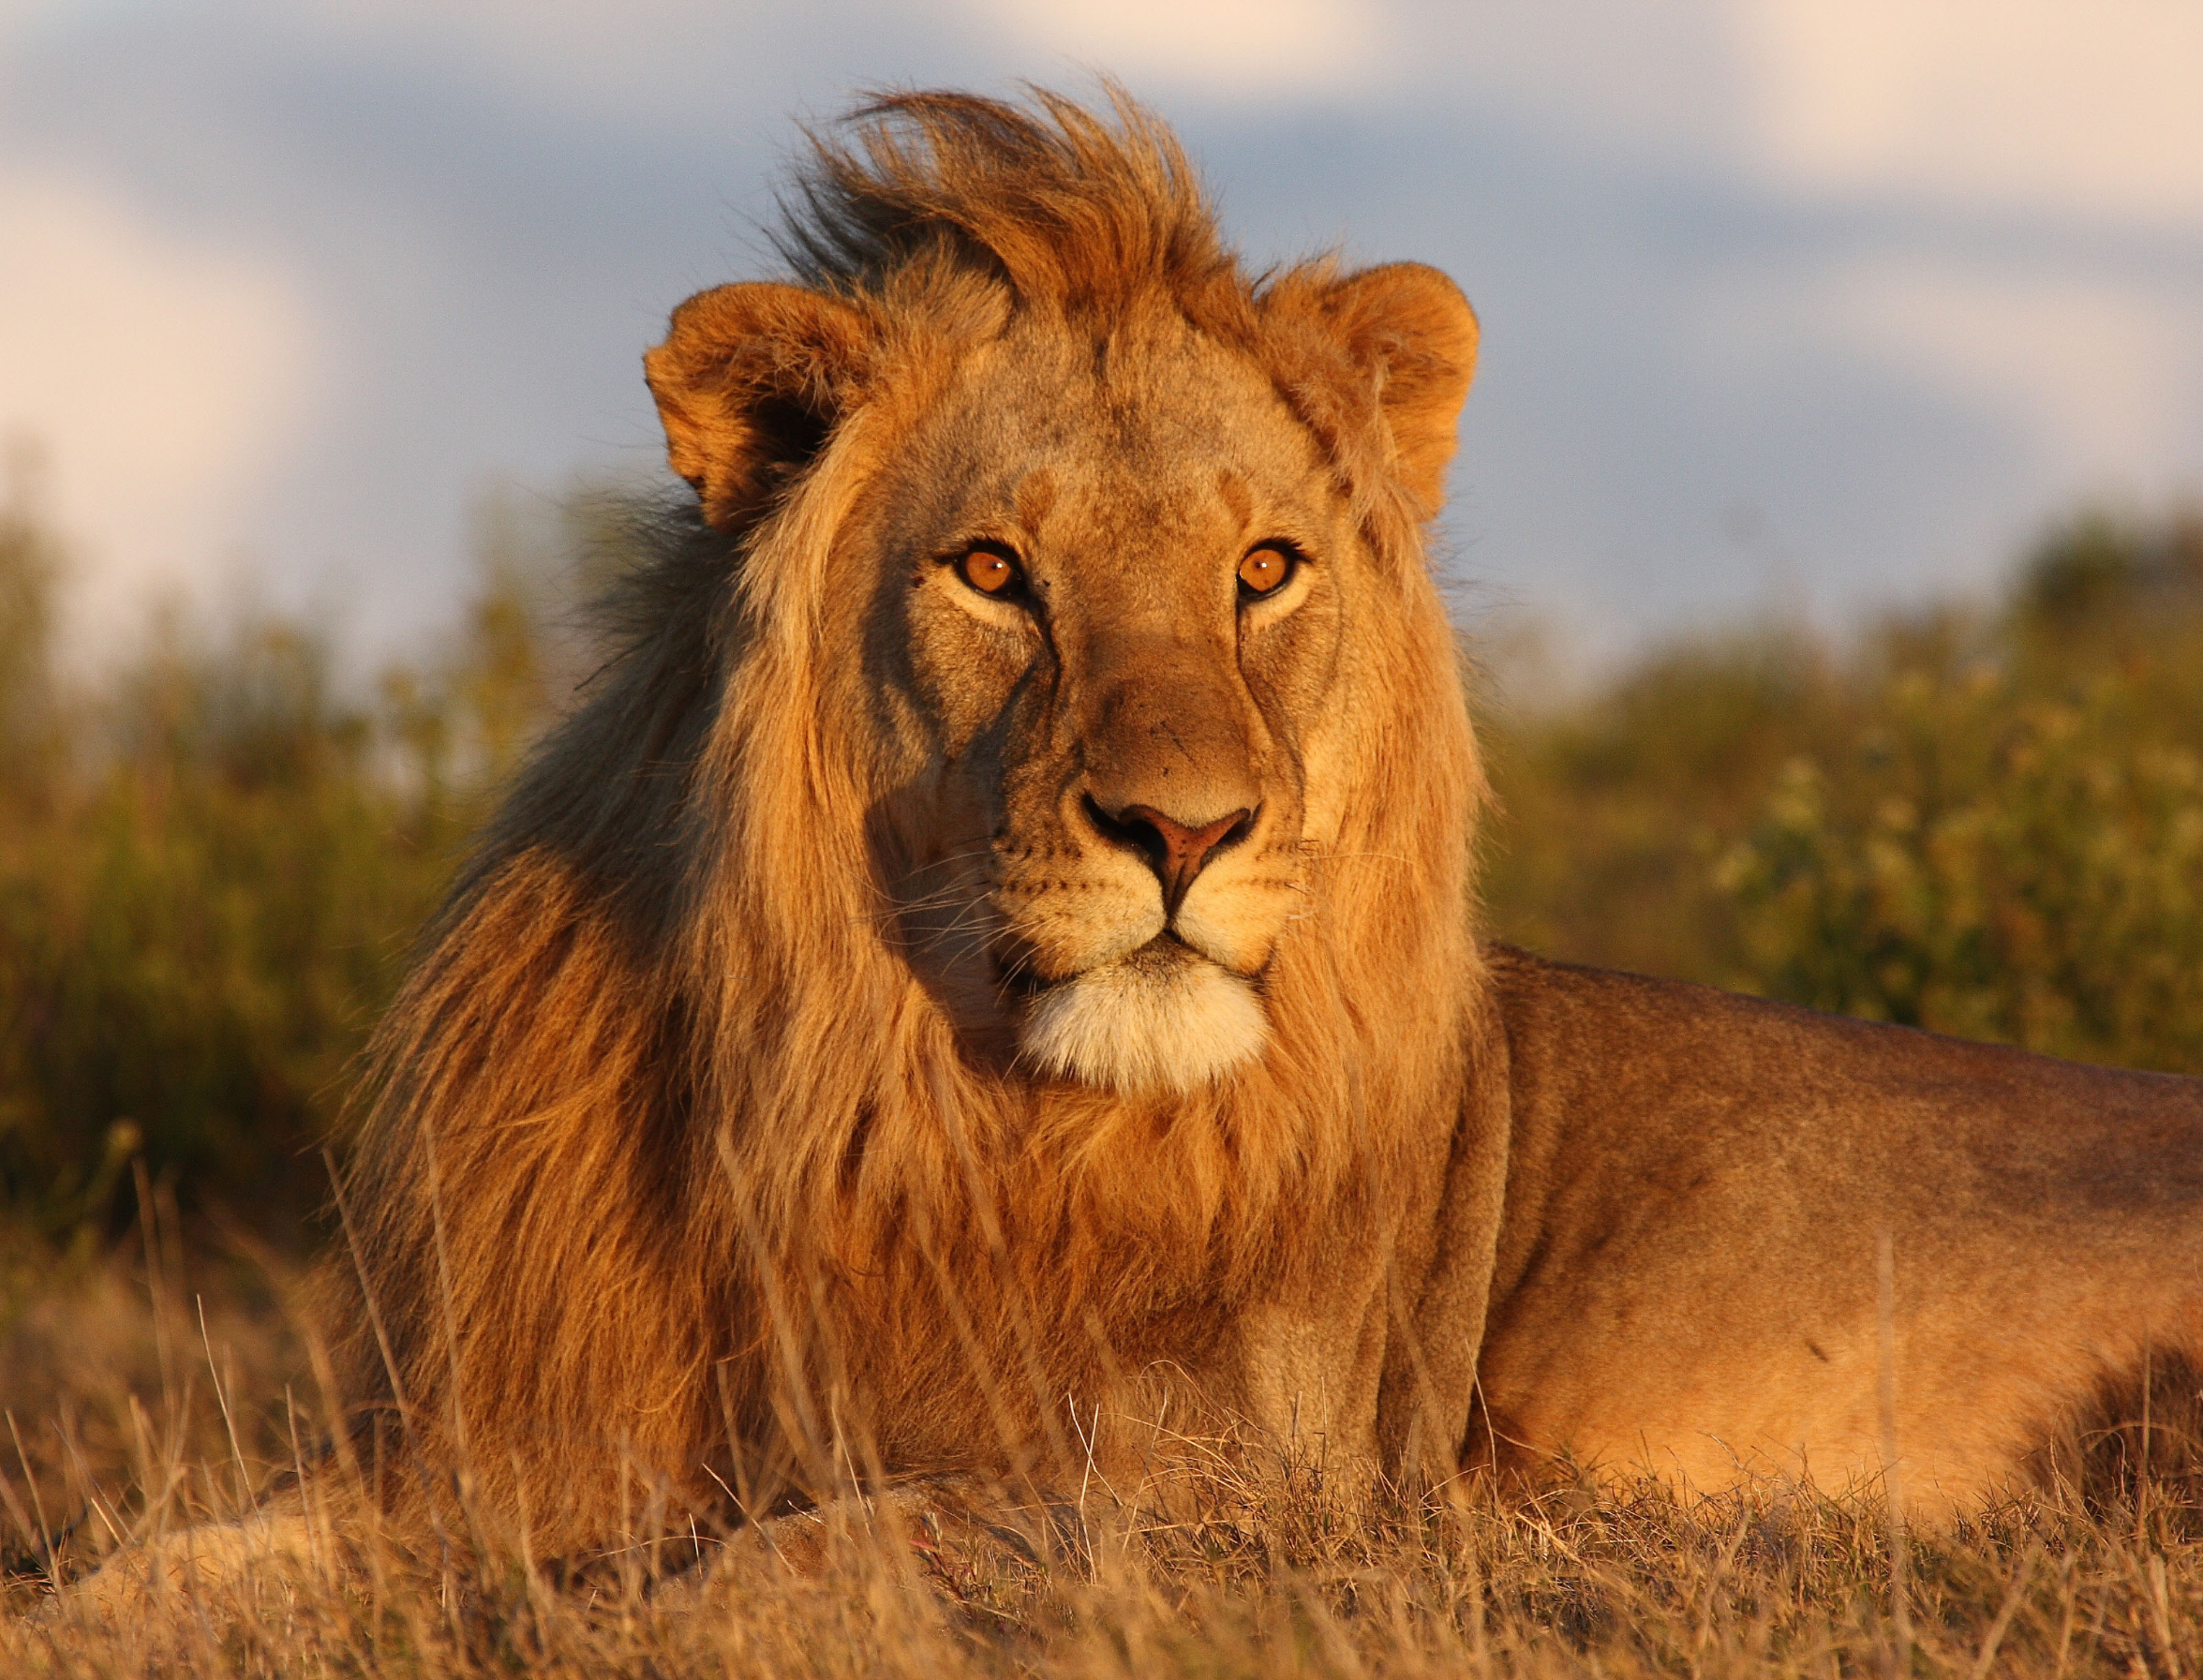
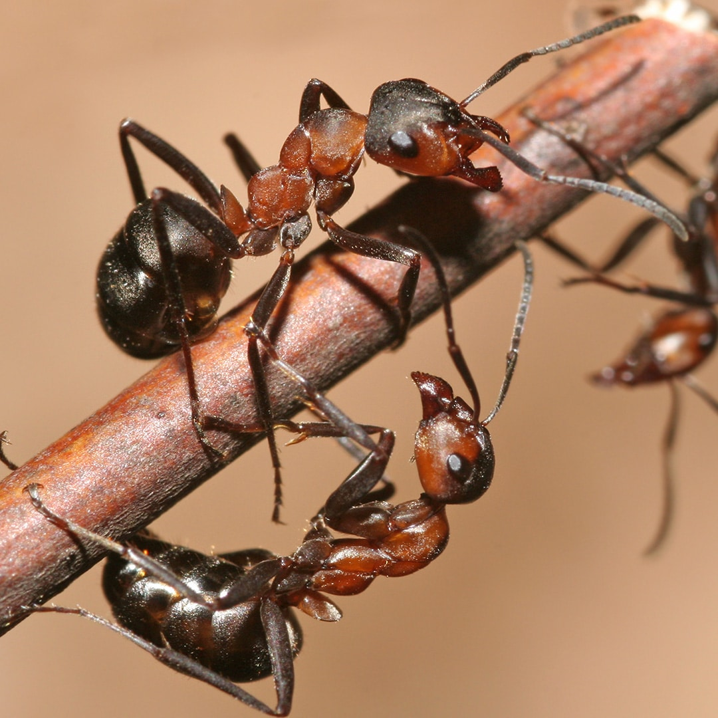
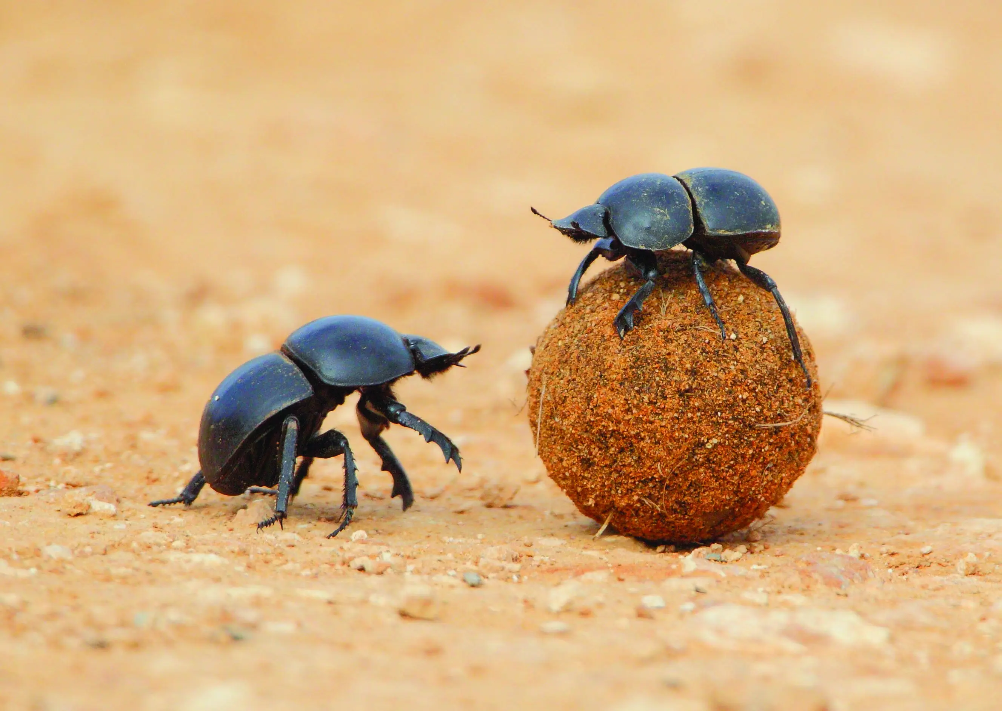
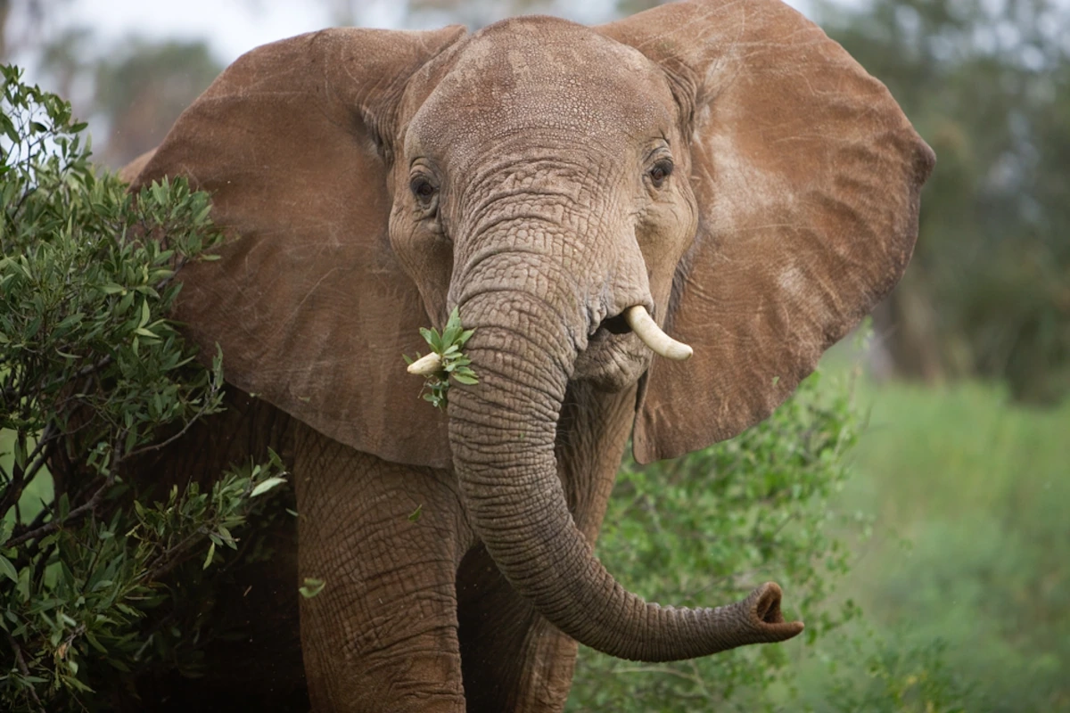
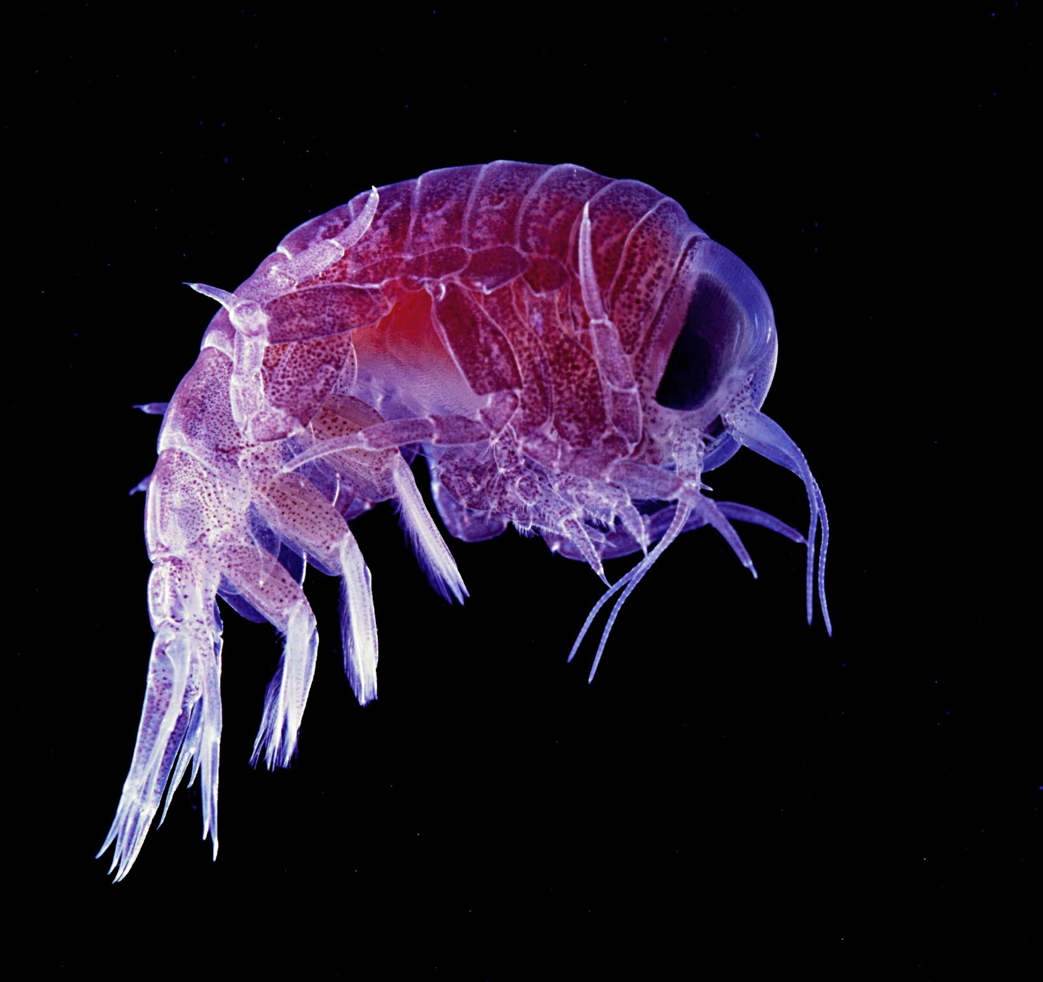
How do we value species?

Slide 13
How do we understand our relationship with non-human animals?
What does it mean to have dominion over something?
What does it mean to be a steward?

Slide 14
Questions to answer:
Where is Okunoshima?
What characteristics do rabbits have that help them avoid predators?
How many rabbits are estimated to be on the island today?
What are the two theories of how the rabbits managed to get on the island?
Why is Okunoshima the ideal place for the rabbits (what is and is not present there)?
Do you think tourism is good for Okunoshima?

