Slide 1
Environmental History

Slide 2
What are we learning today?
When did the environmental movement begin?
What events have shaped the environmental movement?
Why is April an important month for the environmental movement?

Slide 3
April 22nd is a special day, does anyone know why?

Slide 5
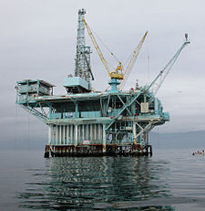
1969 Santa Barbara oil spill
10,000 oil barrels were spilled into the Santa Barbara channel
~3500 sea birds were killed
Declaration of Environmental Rights created 1 year later
Environmental Rights conference
"the conference was sort of like the baptism for the movement."

Slide 6
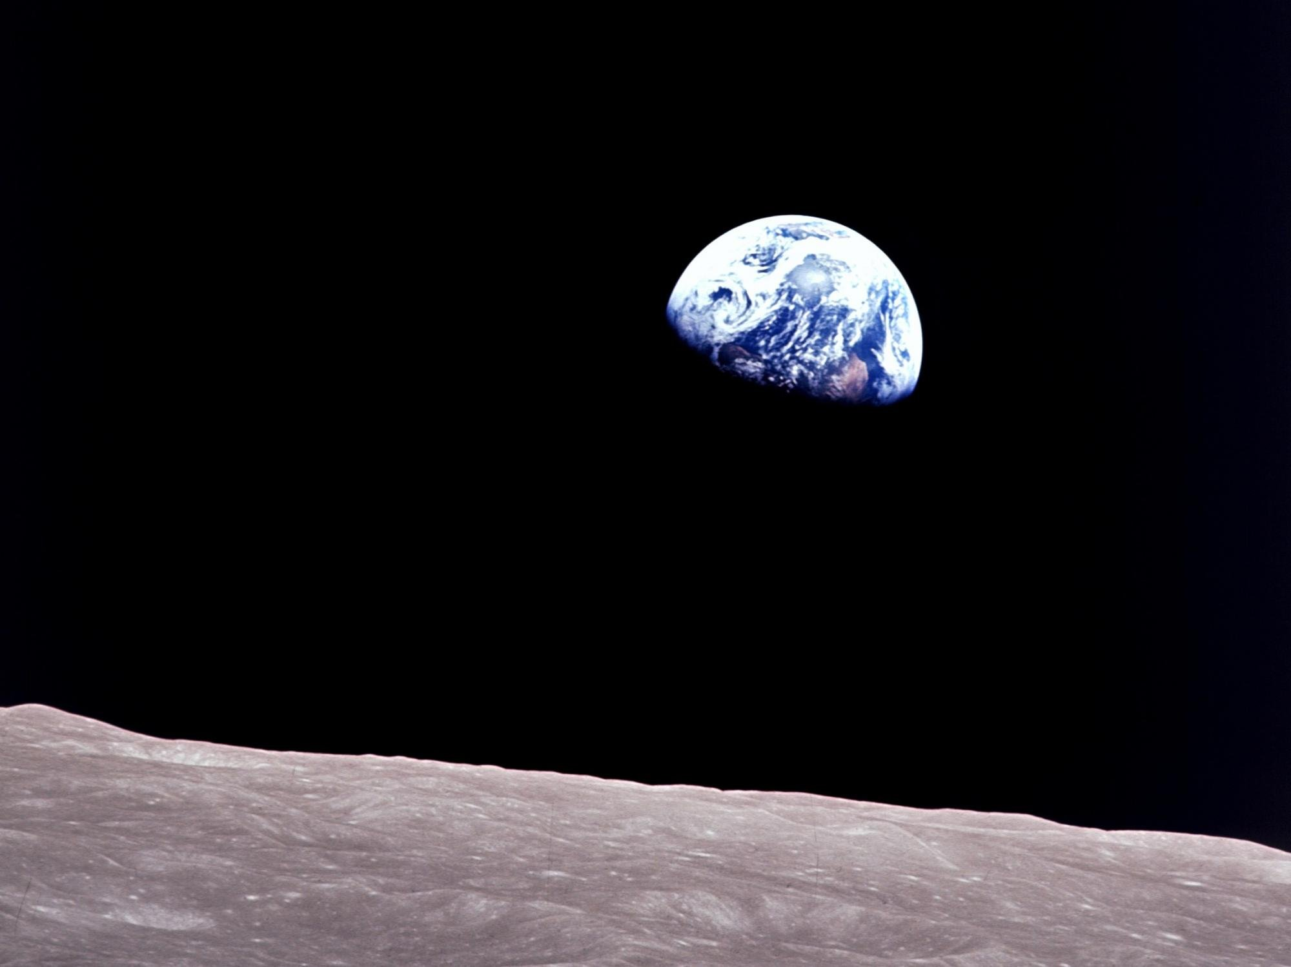
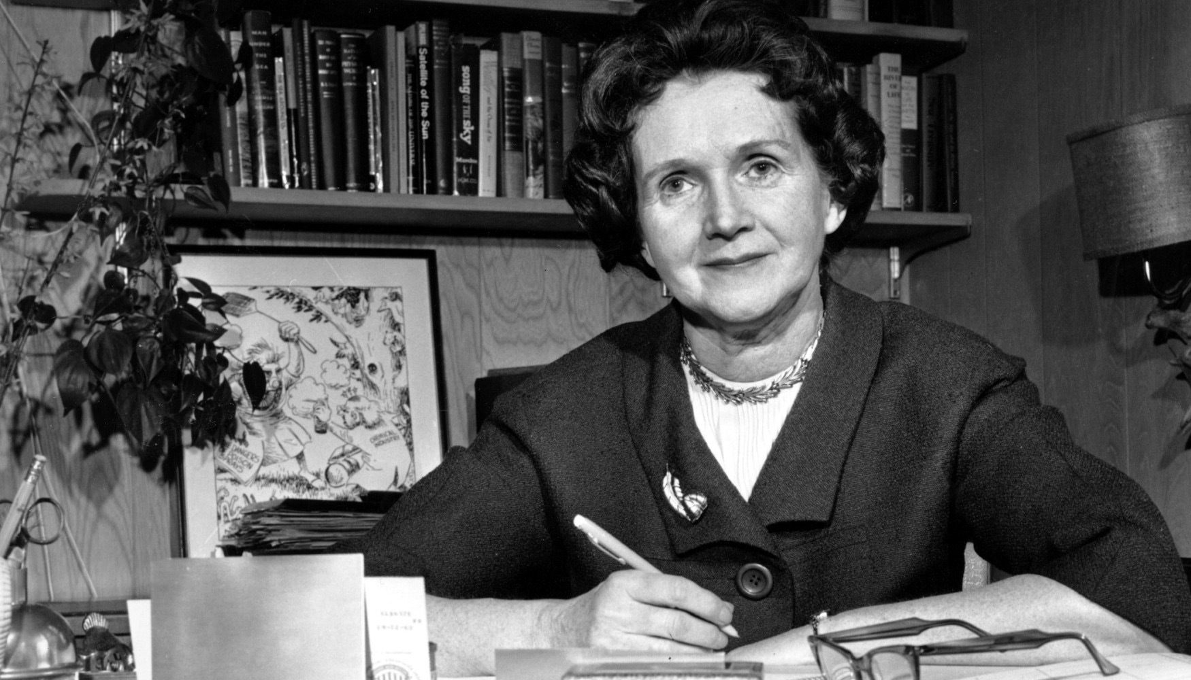
Earthrise
"the most influential environmental photograph ever taken".
Silent Spring published by Rachel Carson
“the book that launched the environmental movement”

Slide 8
What was the name of the pesticide that Rachel researched?
For how many years did Rachel research before writing Silent Spring?
What happened 10 years after the publication of Silent Spring?
How did people react to Silent Spring?

Slide 9
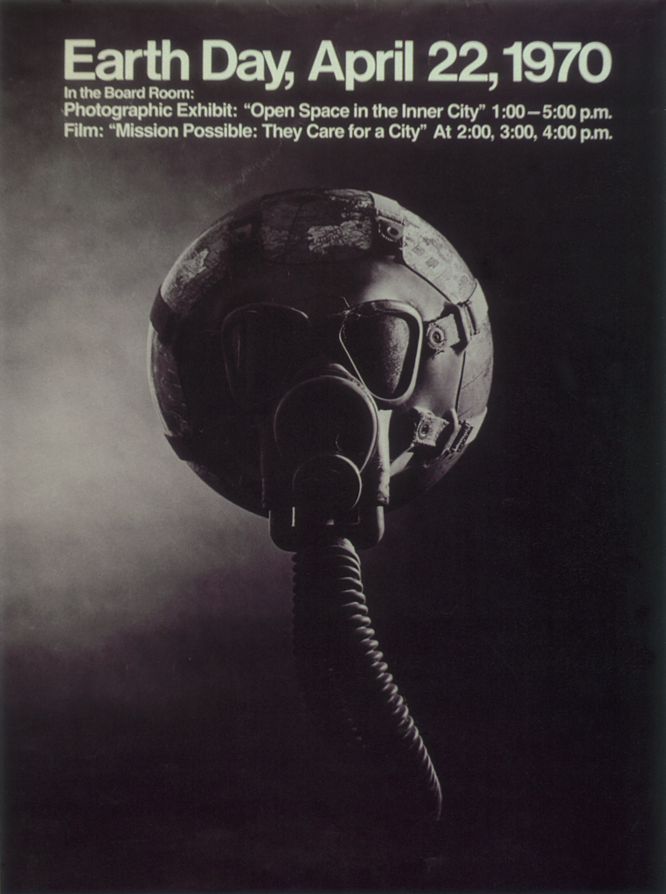
The first Earth Day
20 million Americans protested on the streets for more radical climate action
Pollution was focused on in particular
Earth Day is now observed in 192 countries
Earth Day has become "the largest secular day of protest in the world, and more than a billion people participate in Earth Day actions every year.

Slide 11
Does anyone know any other important days within environmental history?

Slide 12
Exxon Valdez oil spill
The Fridays for Future movement begins
Paris Agreement goes into effect
The Antarctic ozone hole is discovered
The UN adopts the SDGs

