Slide 1
Oceans and Plastic

Slide 2
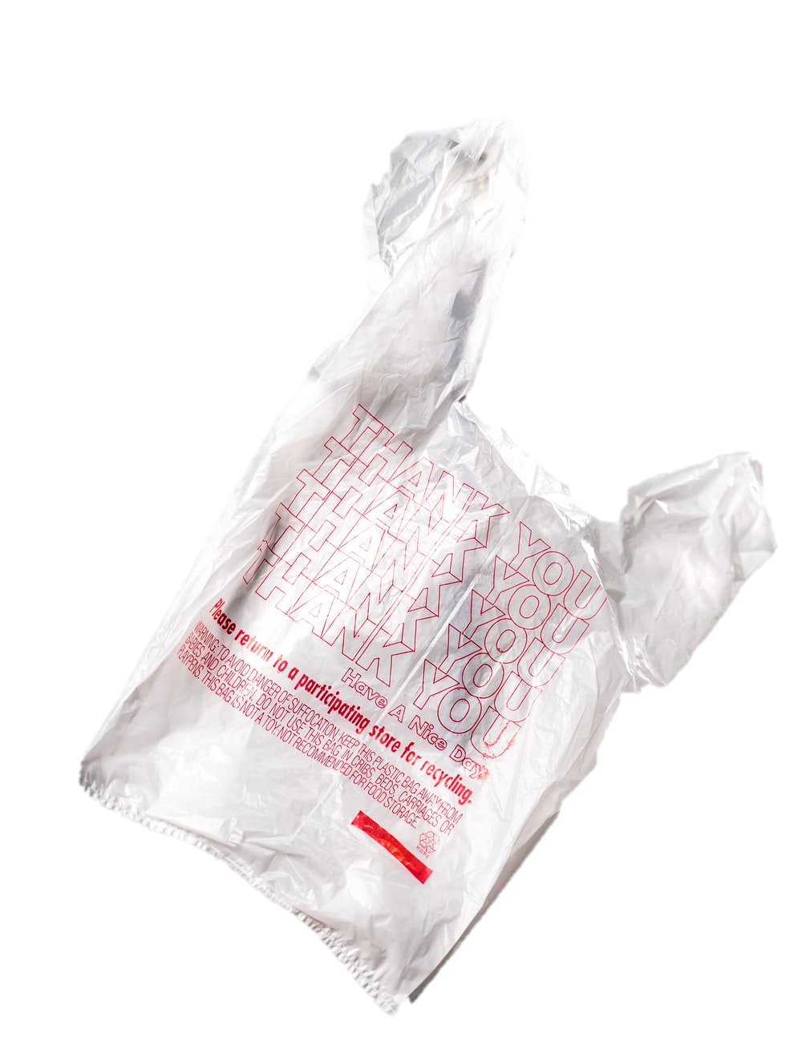
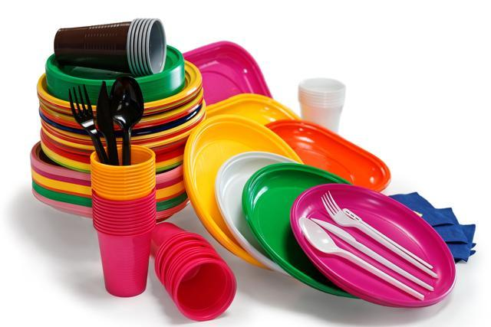
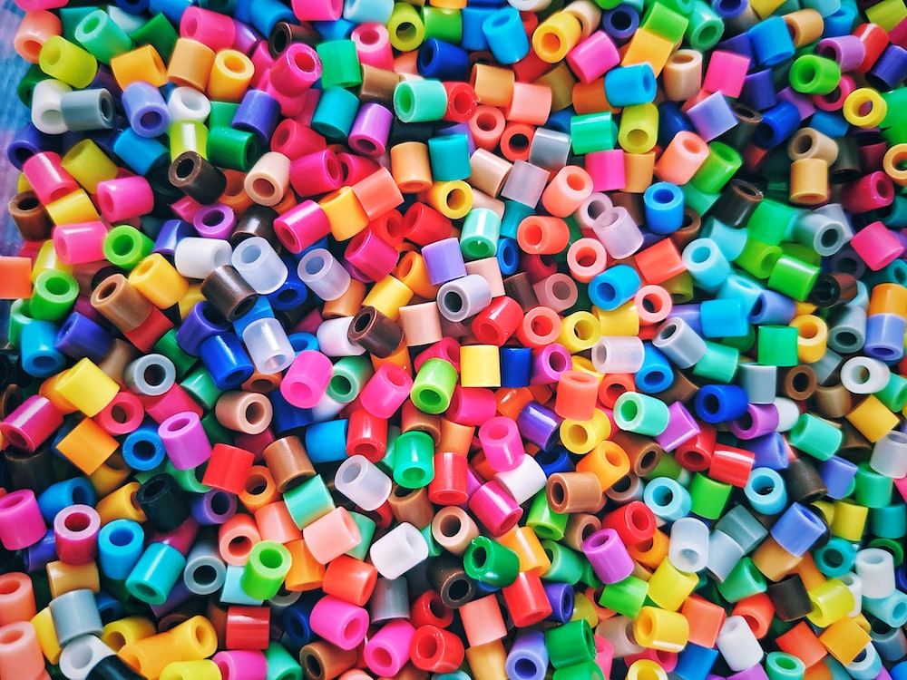
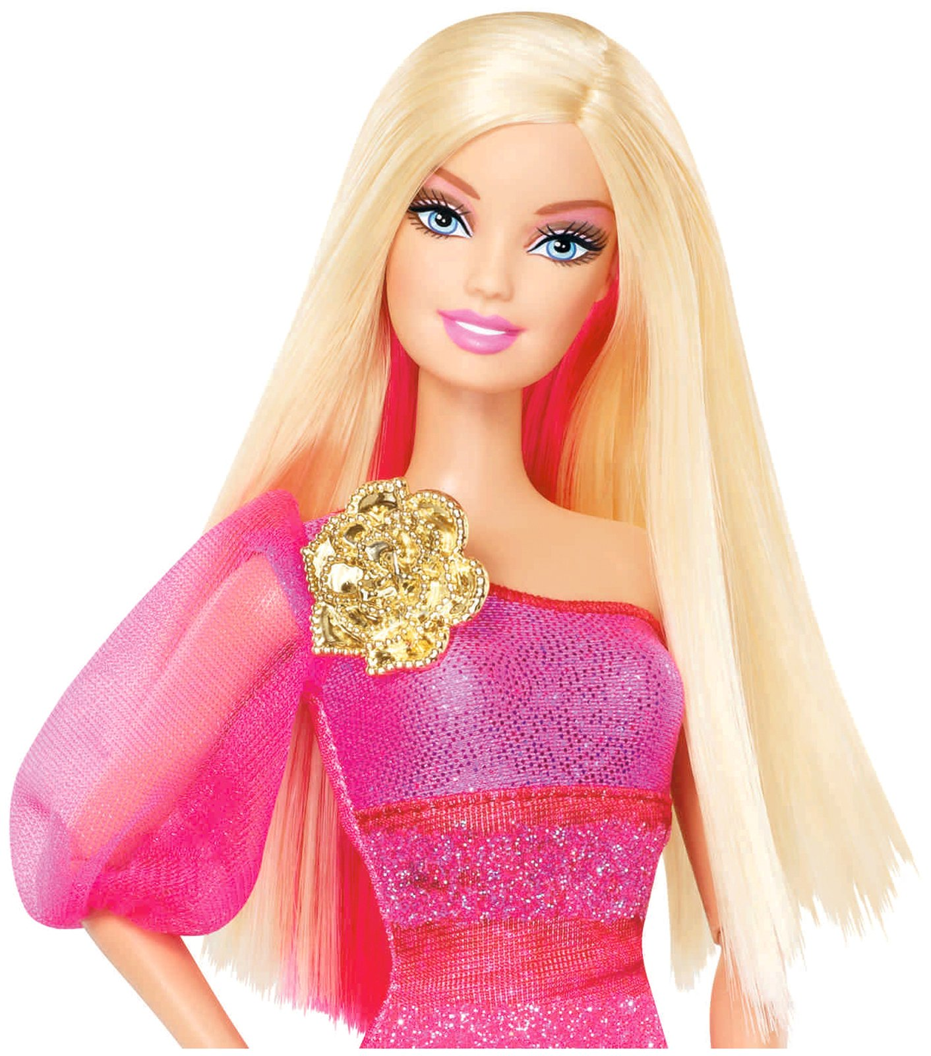
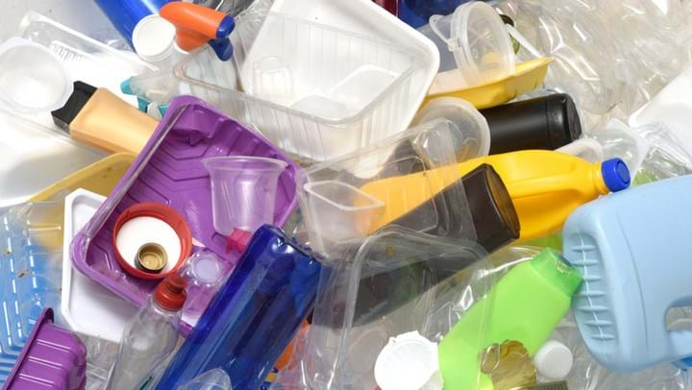
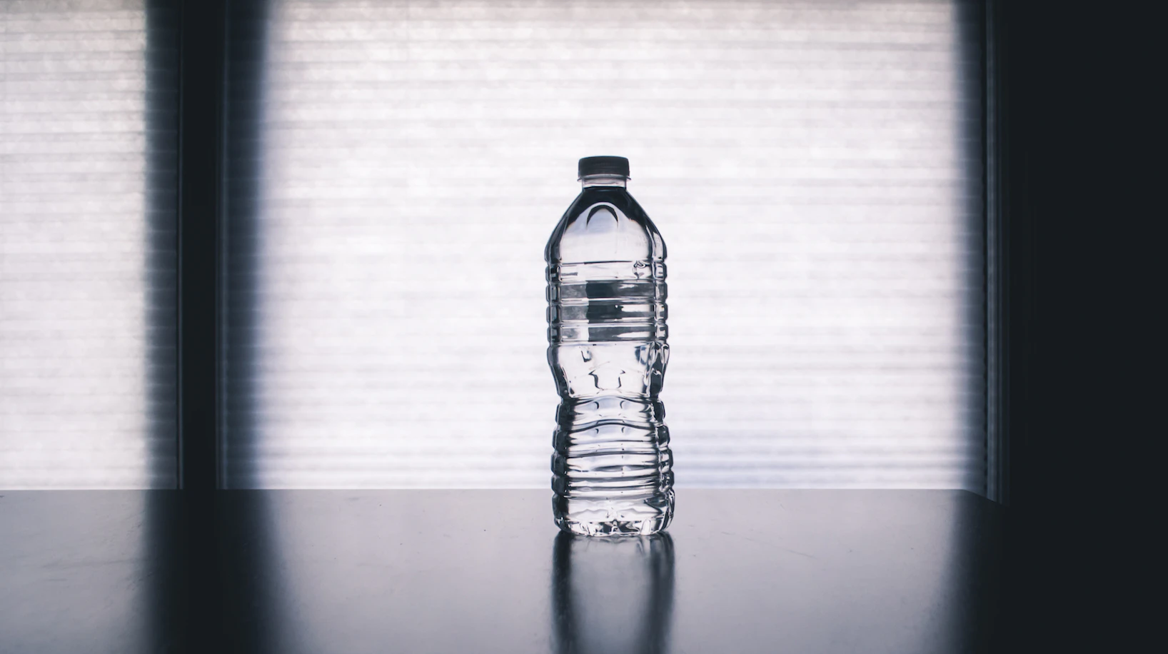
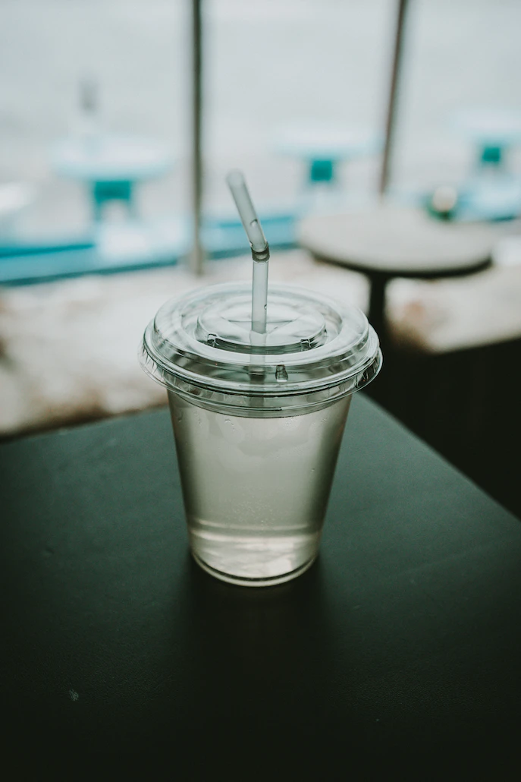
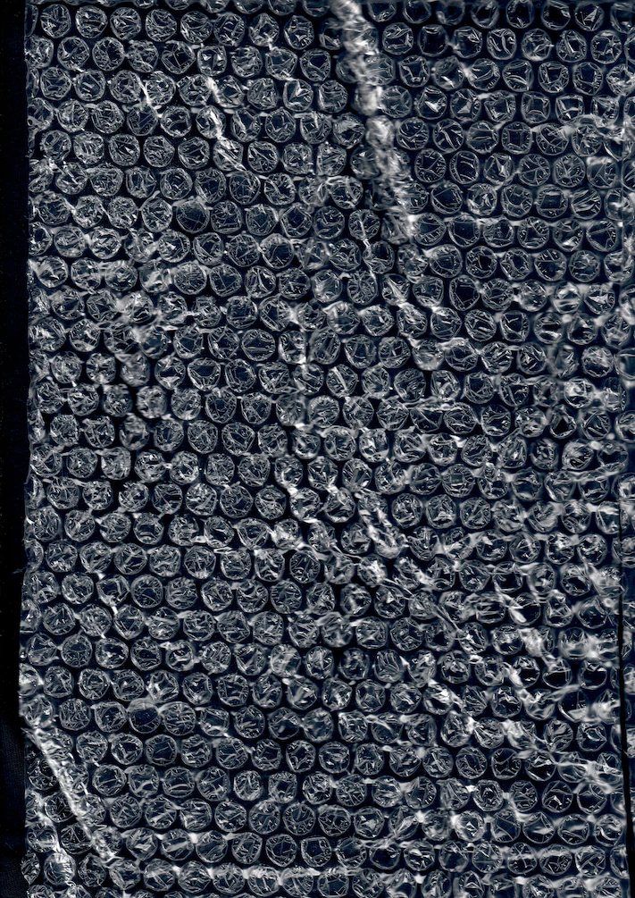
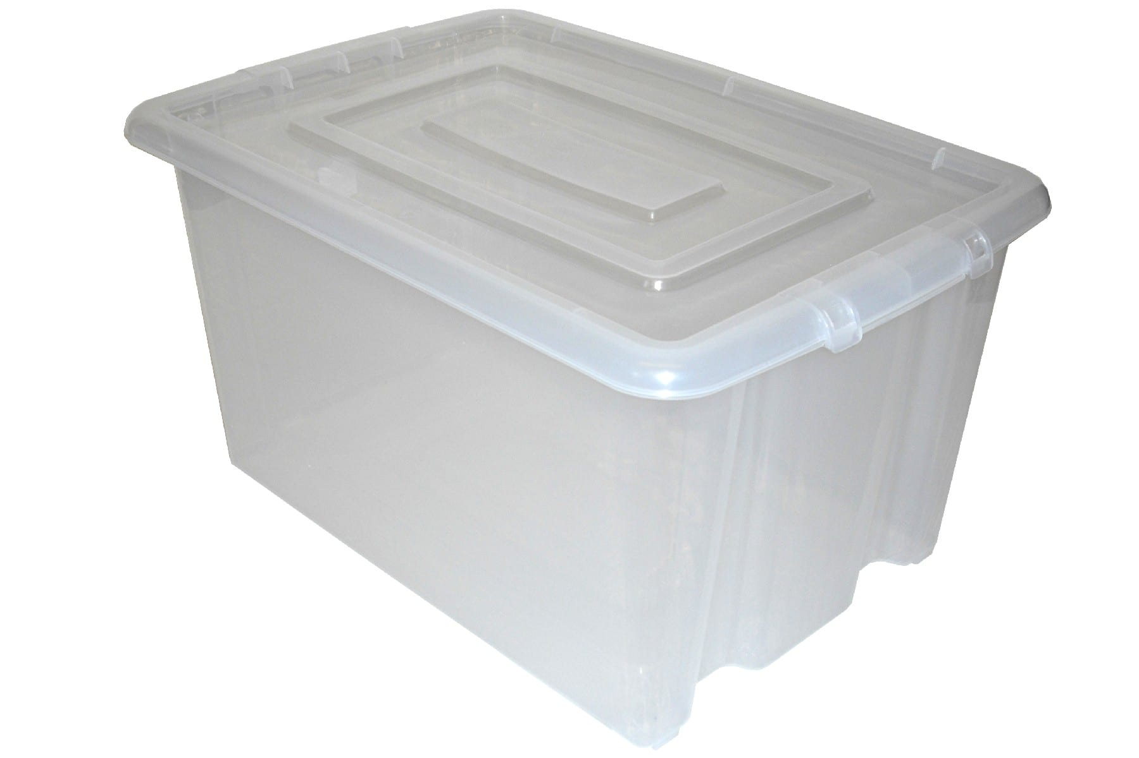
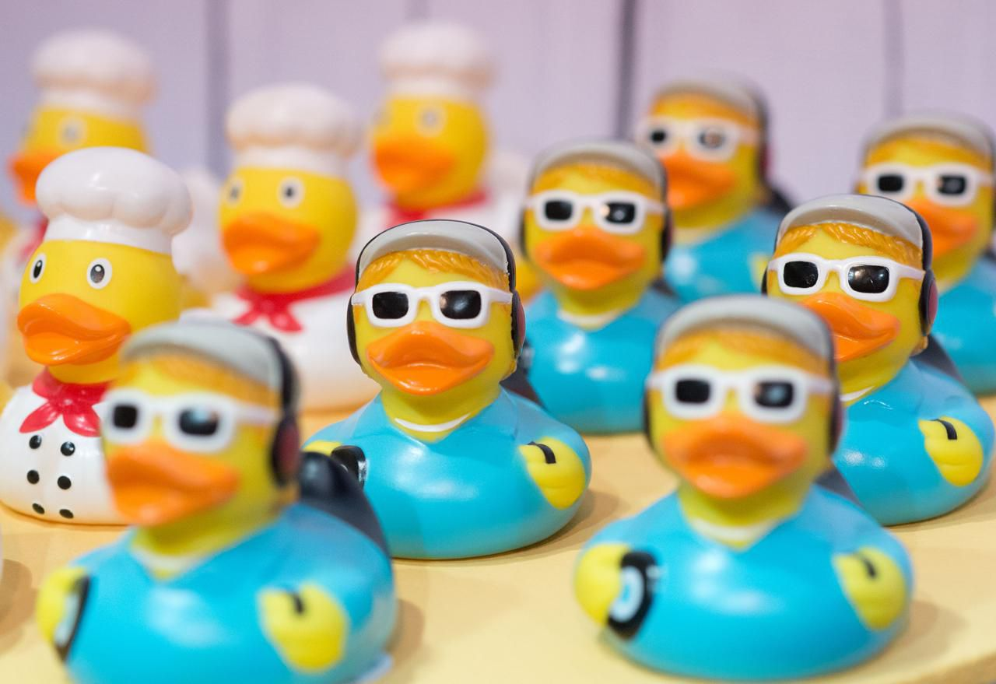
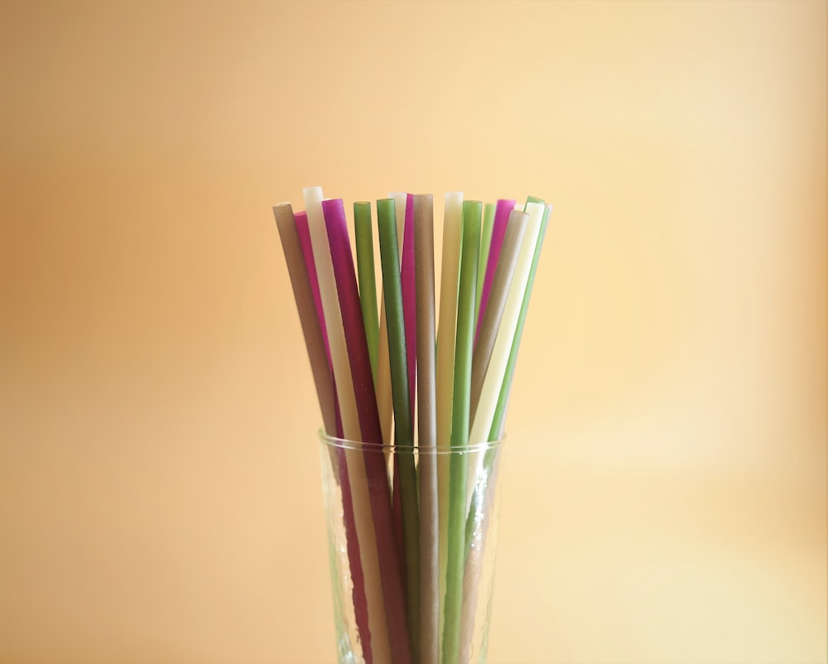
Notes:
Share how plastic has permeated into the everyday. When we think about how to store things, the most effective way to quickly grab a drink etc. It is always plastic that we choose first (or at least think of first). Toys, food and drink, storage all use plastic as their first option. Does it always have to be this way?

Slide 3
What is plastic?
Plastic is a synthetic material, typically made from fossil fuels. Though, there are some plastics that are made substantially from renewable plant materials like starch
The name ‘plastic’ refers to one of its properties: the ability to deform without breaking.
Plastics are usually used as packaging materials, but can also be used in construction (pipes, gutters, door and windows), textiles (stretchable fabrics, fleeces), toys, and electronics.
Plastic takes a long time to decompose, many larger plastic pieces breakdown into microplastics!

Slide 4
How many years does it take plastic to decompose?
Up to 500 years
Up to 10,000 years
Up to 100 years

Slide 5
How small must a piece of plastic be to be considered a 'microplastic'?
Smaller than 5mm
Smaller than 1cm
Smaller than 1mm

Slide 6
How much plastic has the world produced?
Around 9 billion tonnes
Around 20 billion tonnes
Around 2 billion tonnes

Slide 7
What percentage of marine waste does plastic make up?
20%
50%
80%

Slide 8
How much of the plastic produced every year is single use plastic?
20%
80%
40%

Slide 9
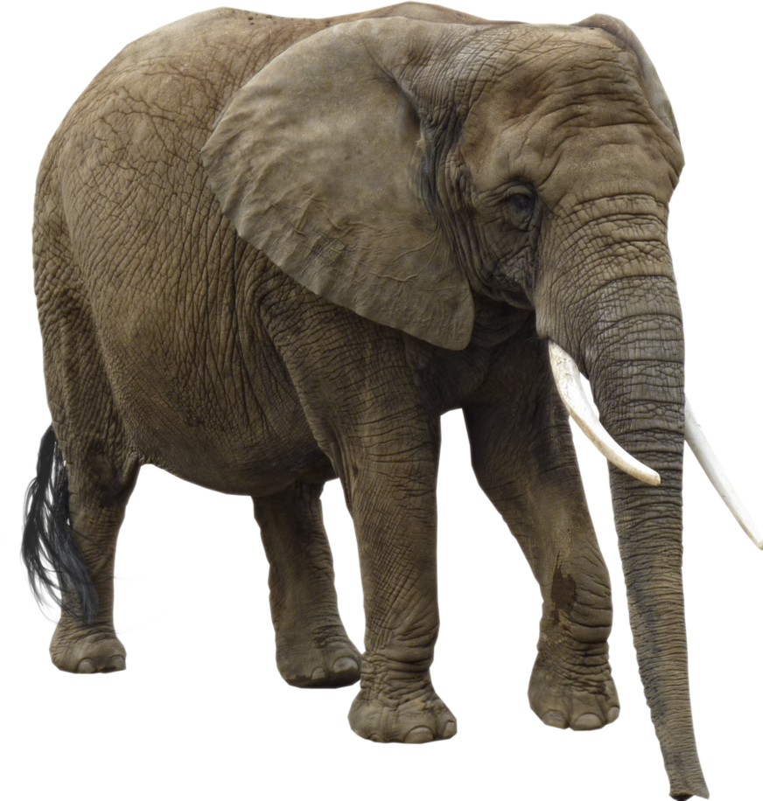
How many tonnes of plastic is produced each year?
100 million tonnes
200 million tonnes
300 million tonnes
That's about the same as 50 million fully-grown elephants!

Slide 10
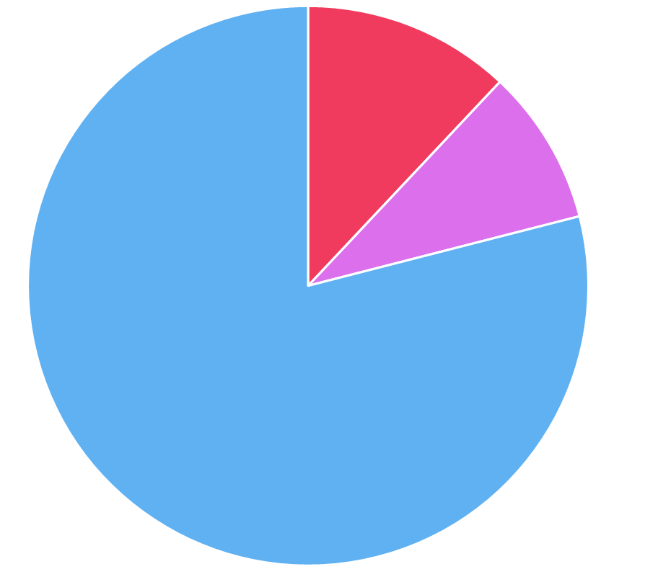
The plastic problem
Sent to landfill
Recycled
Incinerated
What would happen if we used less plastic altogether?

Slide 11
Ocean Gyres and ‘Friendly Floatees’

Slide 12
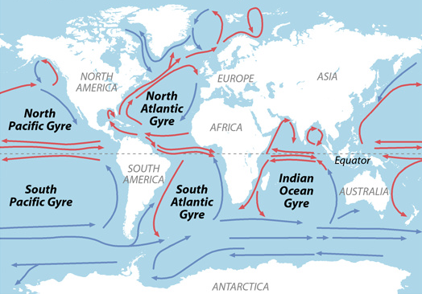
Our litter here
And here!
Can affect people over here!

Slide 13
The Great Pacific Garbage Patch
A gyre of marine debris particles, in the central North Pacific Ocean
The garbage patch is estimated to be around three times the size of France!

Slide 14
What might some of the issues be if plastic accumulates in our oceans?

Slide 15
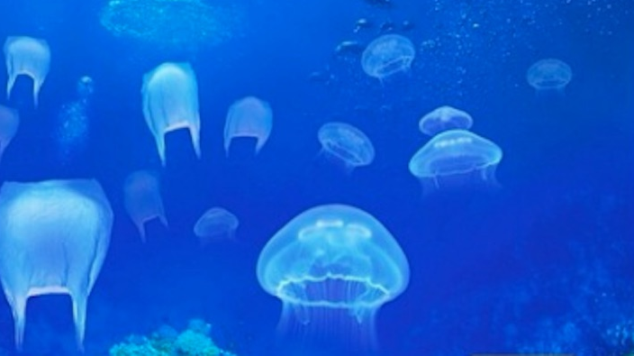
Can you tell the difference between jellyfish and plastic bags in this image? Could a sea turtle?

Slide 16
Biodiversity and Plastic
Over 350 species have been found to have consumed plastic accidentally since records began!
Many ocean species can accidentally ingest plastic. This plastic can get stuck in their digestive system and make them feel like they are not hungry. These species often die prematurely!
Species can also get trapped within plastic! Sometimes this can be very painful, especially if the plastic is sharp. Discarded fishing nets can also trap species, making them unable to move to feed and reproduce.
We, as humans, also end up consuming plastic accidentally!

Slide 17
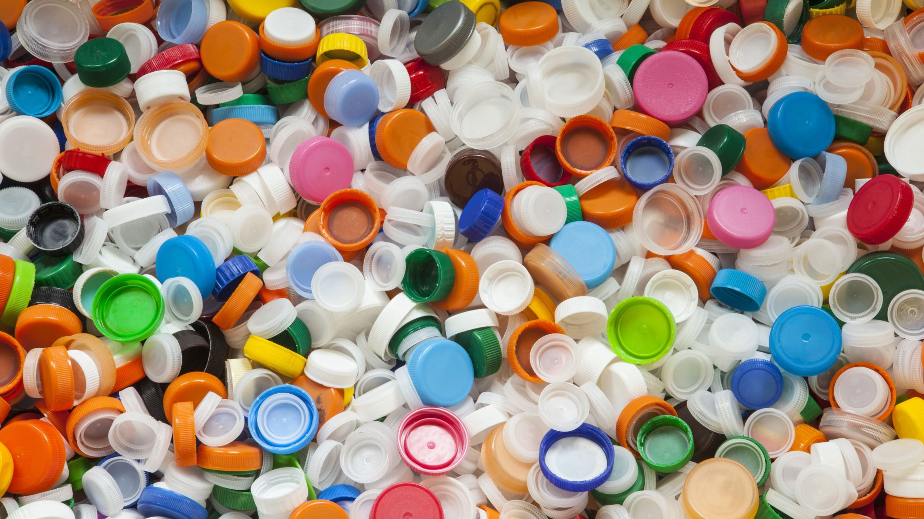
Plastic seems to be everywhere - is a plastic-free future possible?

Slide 18
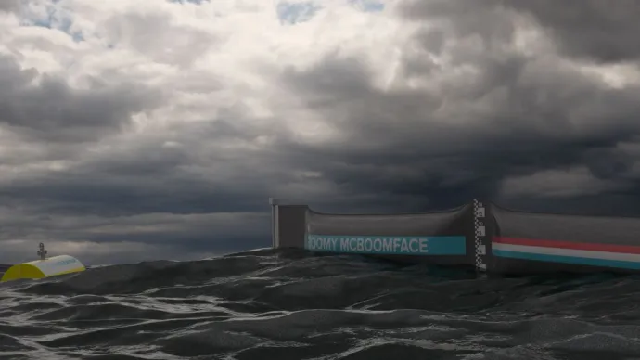
What is being done to tackle the plastic problem?
A policy is a set of ideas or a plan of what to do in particular situations that has been agreed to officially by a group of people, a business organization, a government, or a political party
In response to the plastic issue, some countries have banned the sale of plastic bags or have made customers pay a small amount to use them rather than have them for free
The UK will be banning the use of some single use plastic cutlery by 2024
Businesses are selling products made from alternative materials, like bamboo!

