Slide 1
Sustainable Fashion

Slide 2
What are we learning about today?
What is fast fashion?
What was the Rana Plaza building collapse?
Can purchasing goods ever be ethical?

Slide 3
Where do we get our clothes from?
Kilo sale
Charity Shops
Older siblings
Parents
Fast fashion stores
Online
Hand-made
Sustainable clothes stores

Slide 4
What is the difference between fast fashion and sustainable fashion?
Fast fashion | Sustainable fashion
Very accessible – can be ordered online and arrive quickly. There may be shops nearby | Might take longer to make
Cheap | Sometimes more expensive
Might not know how it was made | Should be able to find information on how the item was made
The item of clothing may not last very long | The item of clothing was designed deliberately to last a long time

Slide 5
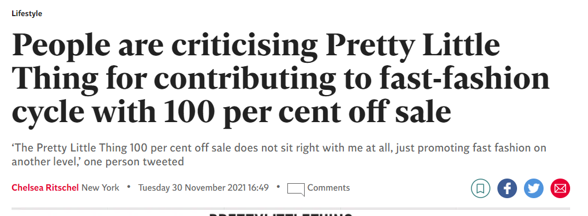

Slide 6
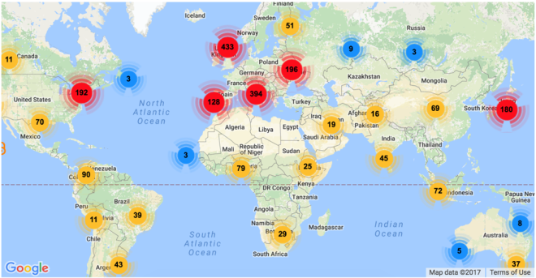
Special Economic Zones
Business-friendly rules
Relaxed employment rules
Fewer taxes

Slide 7
Wage Estimation – how much should workers earn for making our clothes?
The current living wage in the UK is £9.50 – this is the amount of money that is currently believed is necessary to earn per hour to live
It is becoming more expensive to live, many people would like wages to go up to help them
£9.50
£12
3p
£6.50

Slide 8
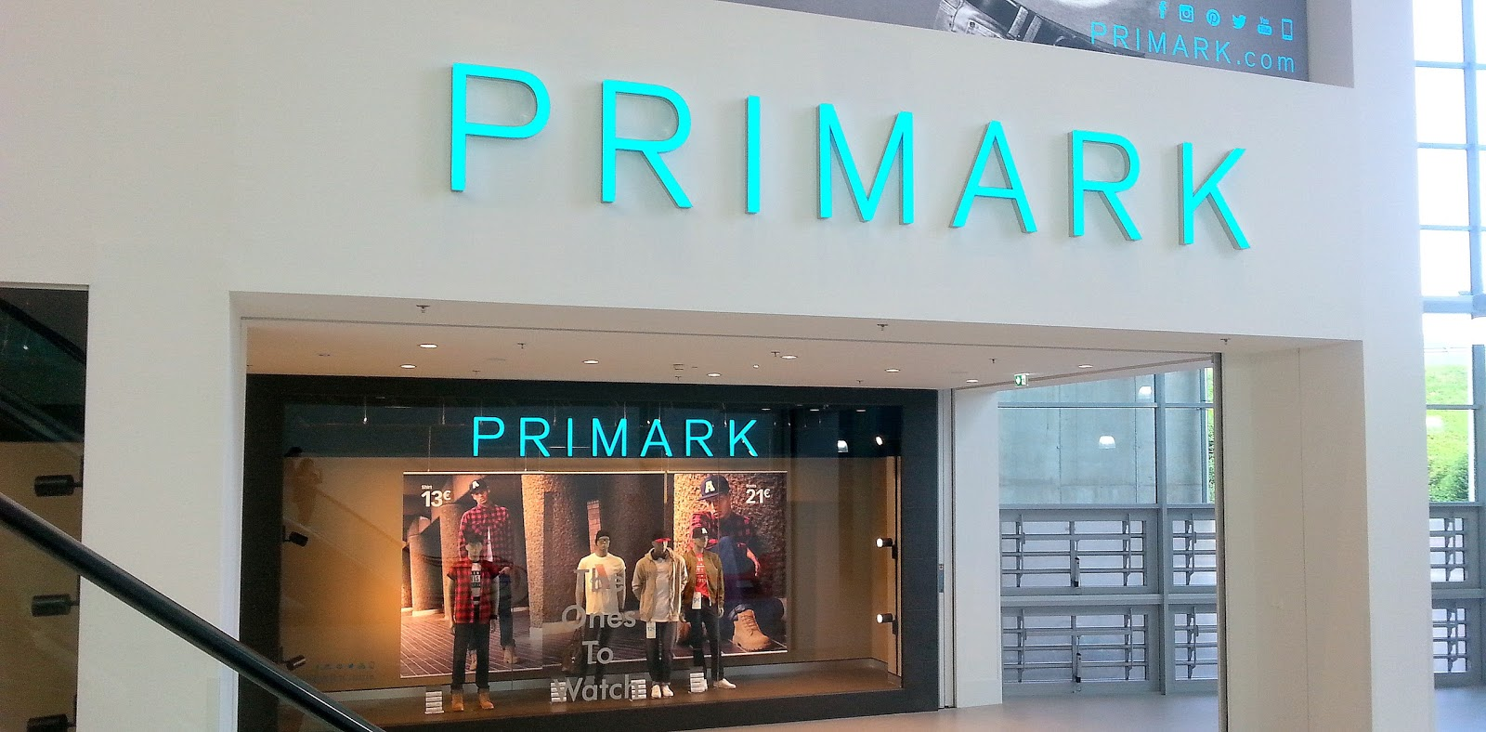
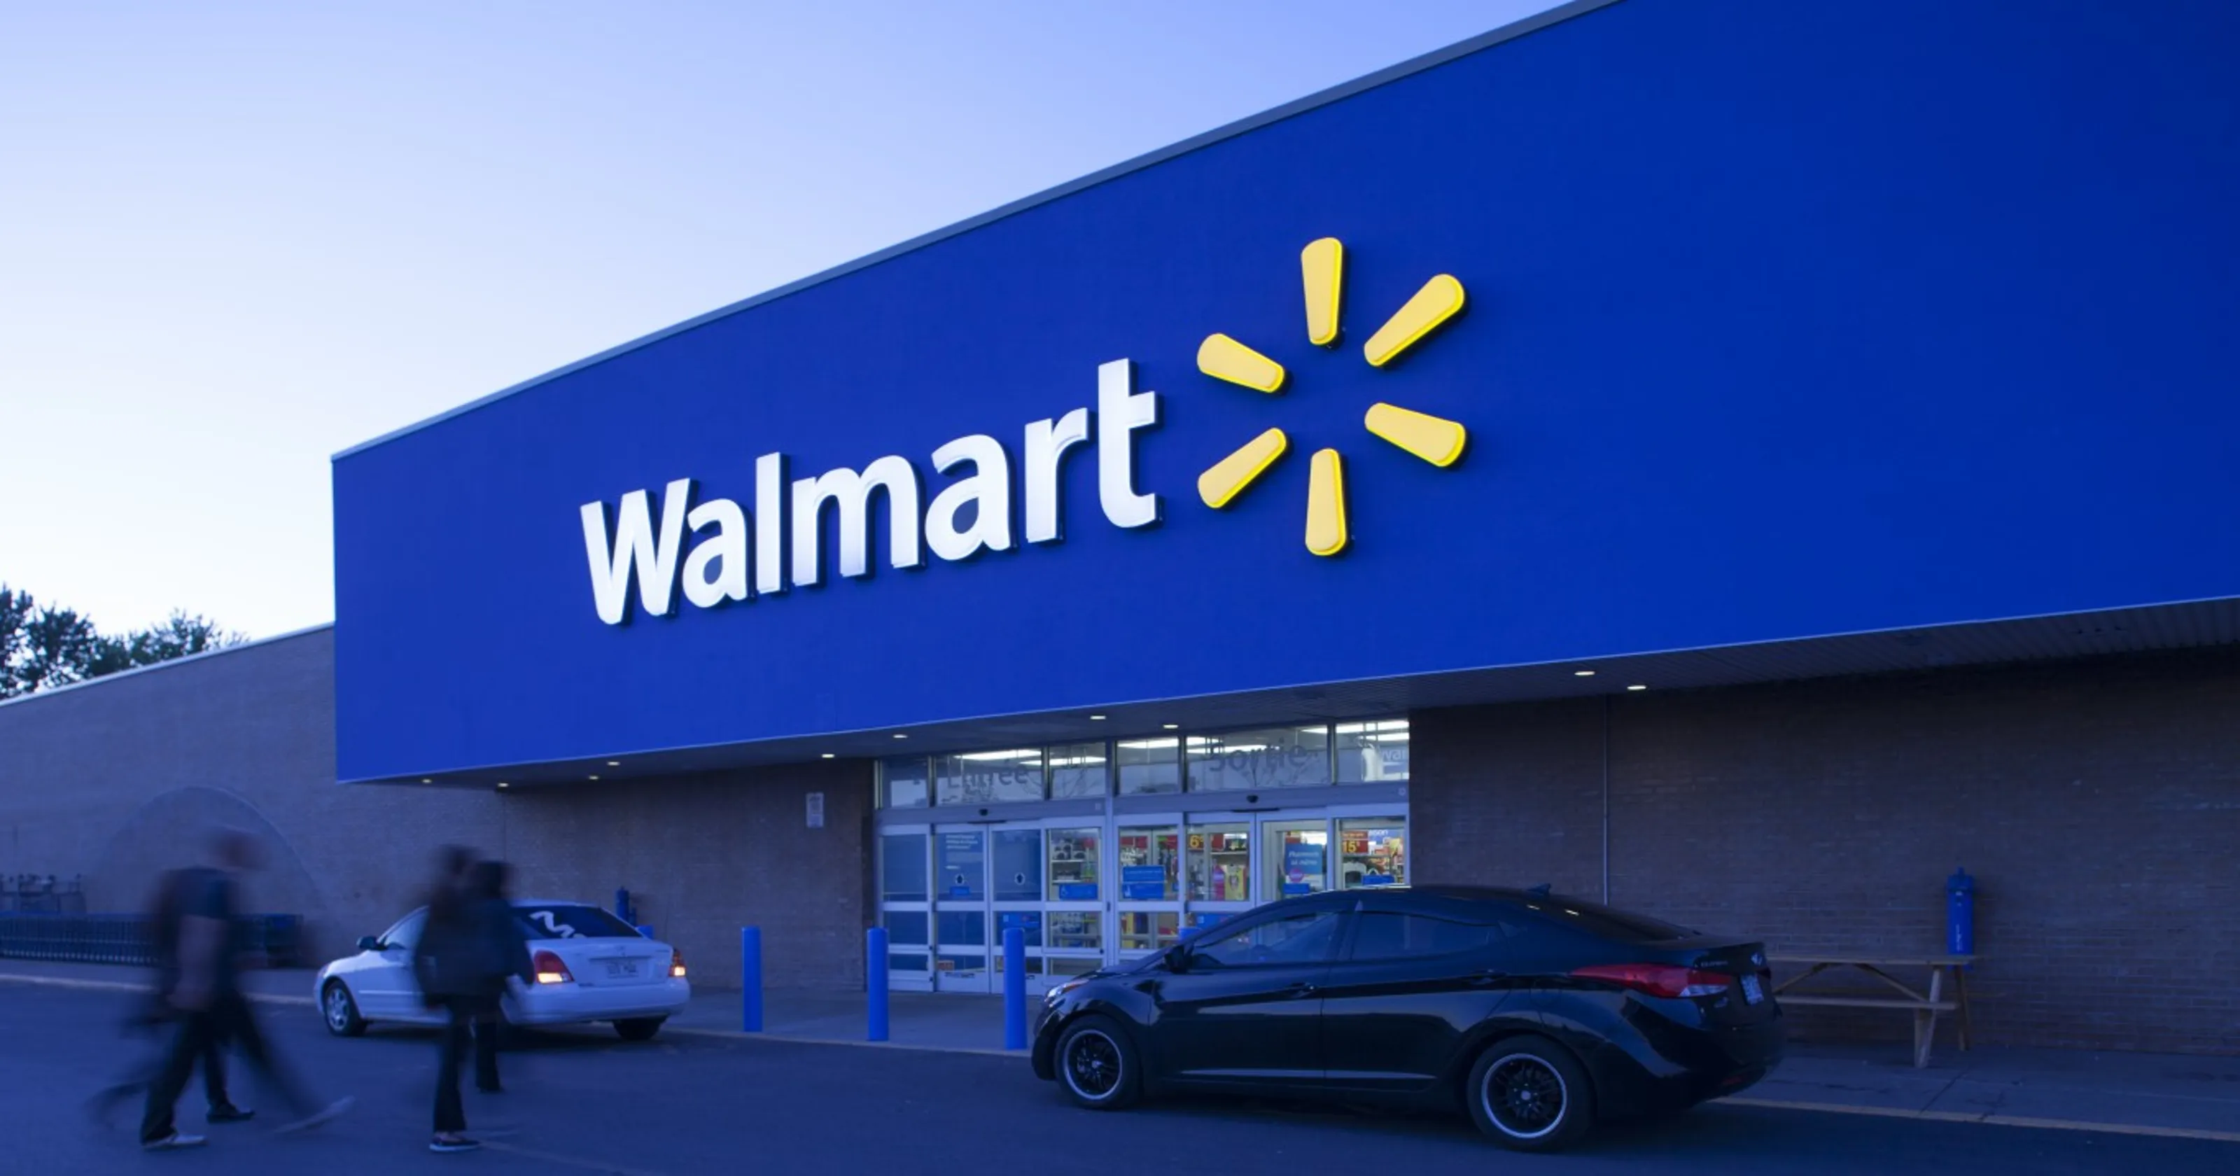
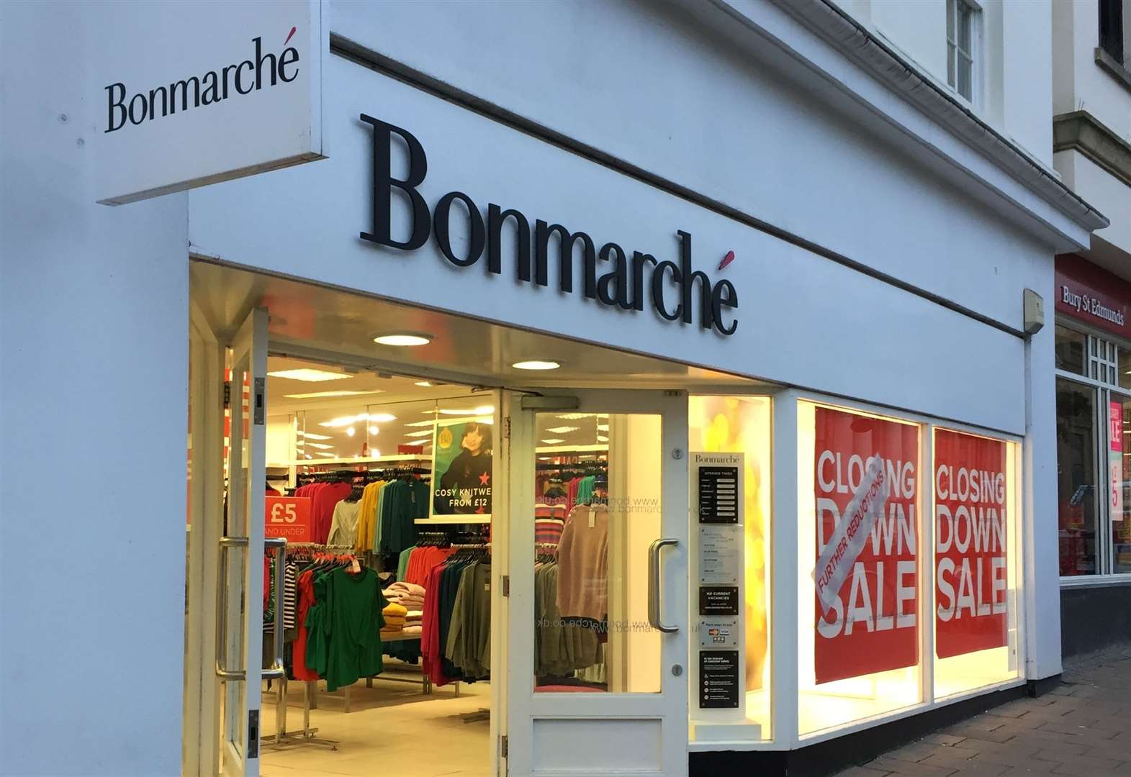
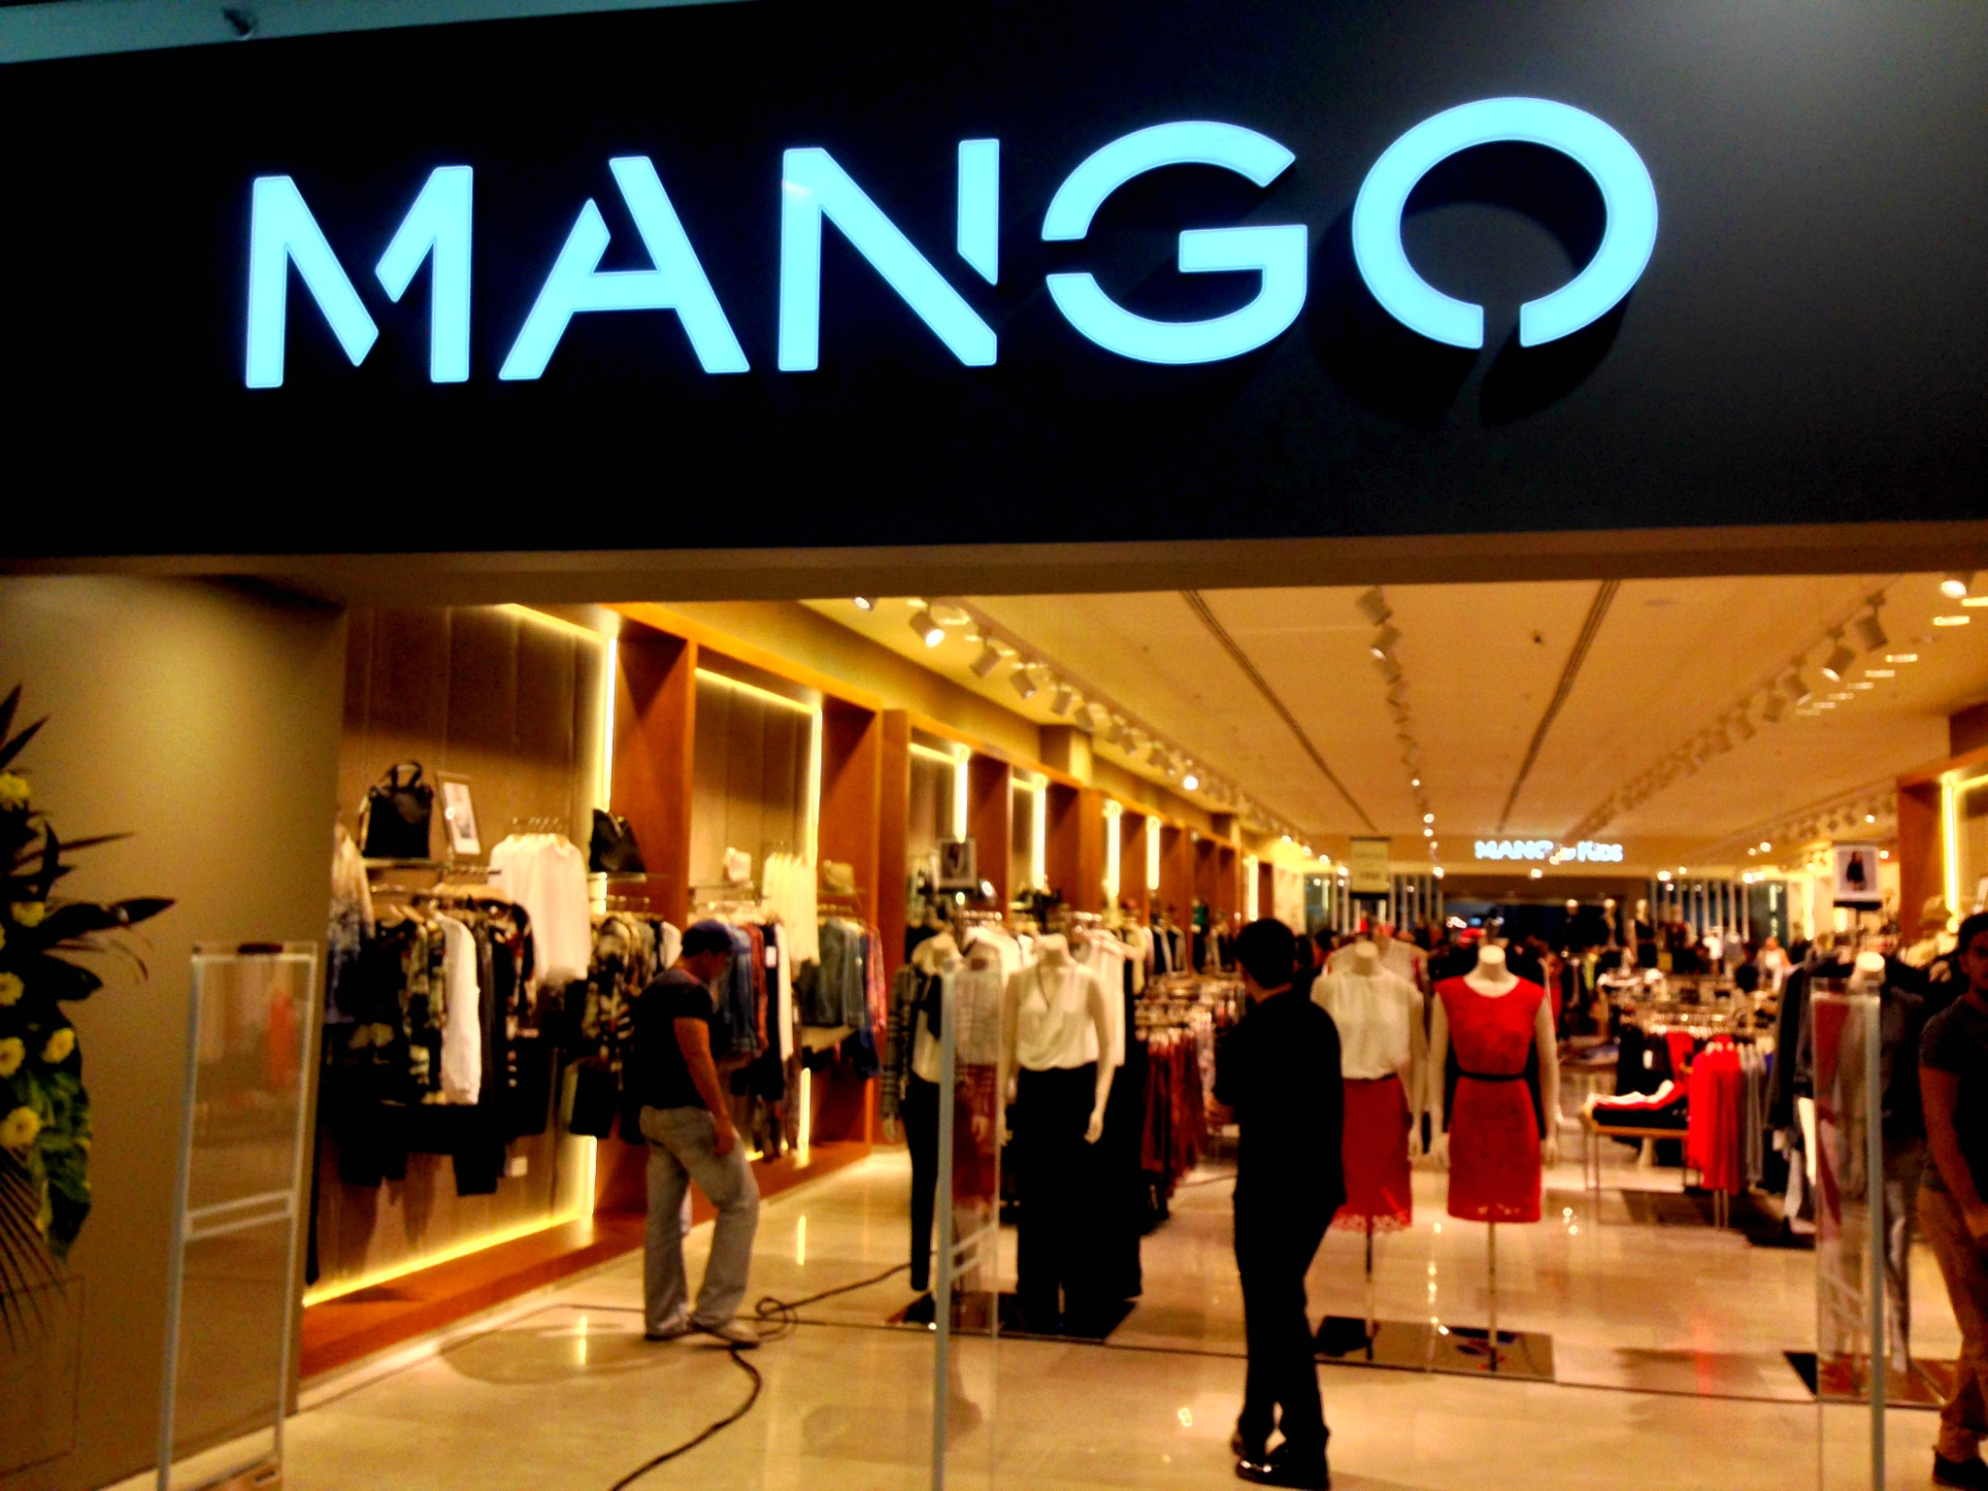
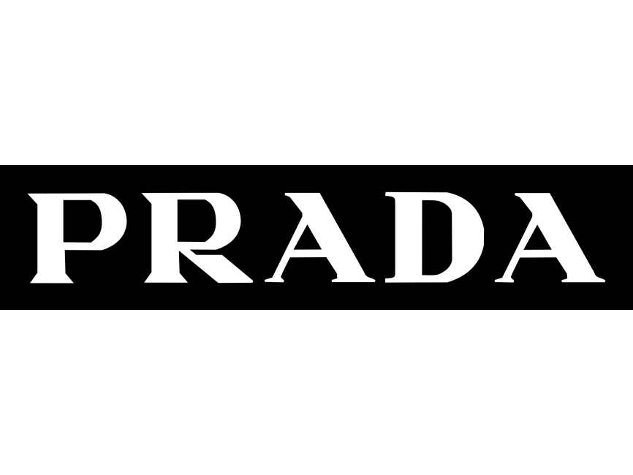
Rana Plaza
In 2013, 1,134 people died after an eight-story building collapsed in Bangladesh
The building contained clothing factories
The building's owners ignored warnings that the building was unsafe

Slide 9
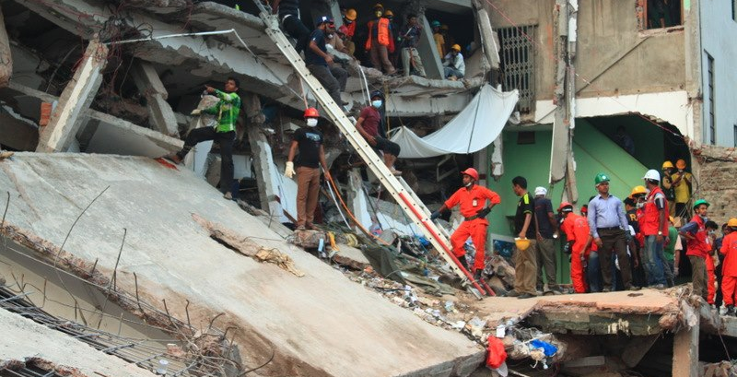

Slide 10
Is it fair that we outsource labour so that our clothes are cheaper?
How will it affect the workers?
How will it affect shareholders?
How will it affect the consumers?

Slide 11
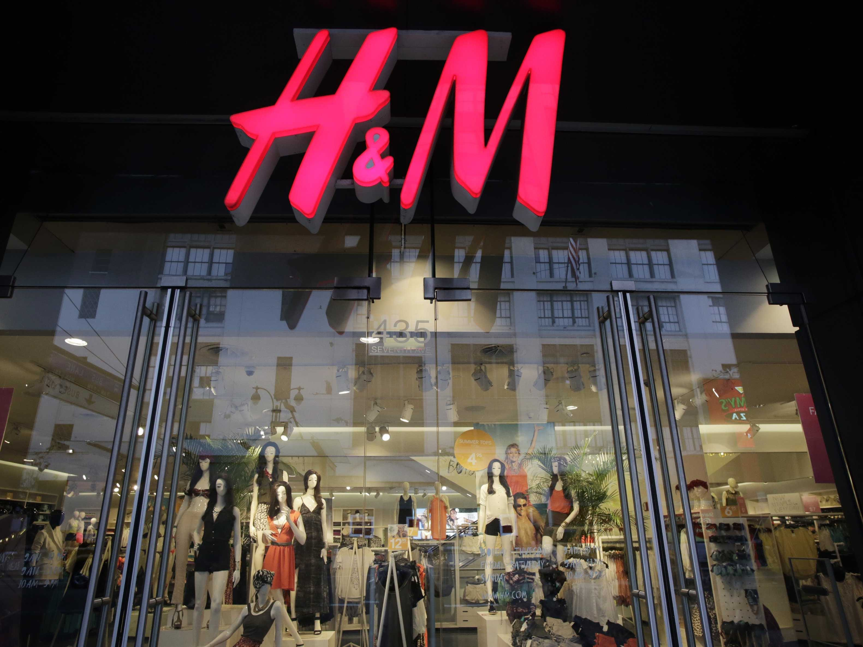
Should we shop at these stores?
No
It's a bit more complicated...
Yes

Slide 13
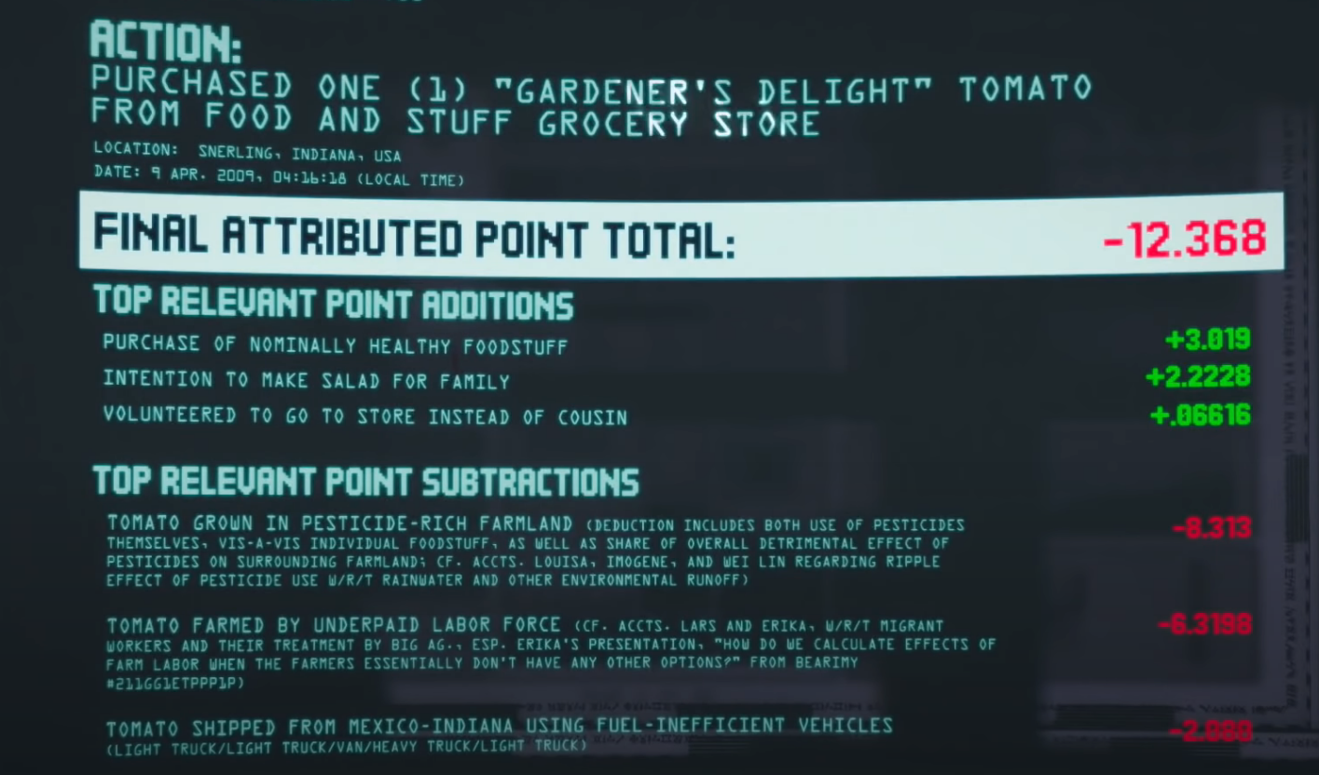

Slide 14
Shareholders get more money
They can spend the money on what they like
They could choose to invest it back into their clothing business...
OR they might keep it for themselves and get richer
Inequality increases
Workers are paid fairly and have time for their families
But workers are happy to come into work, and the factory remains productive, just without unethical levels of profit
Businesses look at how well the factory is doing and want to do the same
Extra profit for shareholders may be lost....
The government notices and makes rules protecting the rights of workers
Governments around the world do the same
The price of the clothes may go up, but everyone's wages have gone up, so they have more money to spend
The factory is making less profit than other factories
The factory is shut down because cheaper clothes can be made elsewhere
Workers are now without jobs

Slide 15
“life now is so complicated, it’s impossible for anyone to be good enough for The Good Place”
What matters isn’t if people are good or bad. What matters is, if they’re trying to be better today than they were yesterday.

