Slide 1
Just Transitions and the Future

Slide 2
What are we learning today?
What is a 'just transition'?
Why is a just transition important?
Case study: Tonawanda, New York
Why is it important to imagine what the future could look like?
What do I hope the future might look like?

Slide 3
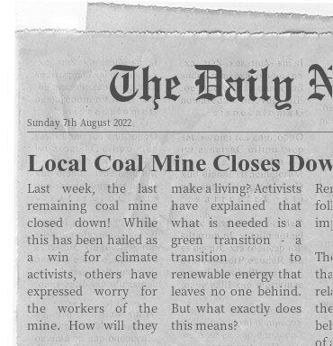
Scenario 1: coal mine closure
The UK’s only remaining coal mine has closed down, meaning that it is now running on 100% renewable energy!
John is happy about this, but as he was once a worker in this coal mine, he and many others are now without jobs. They have spent their lives training to work in coal mines and now have nowhere to go.
What should happen next?

Slide 4
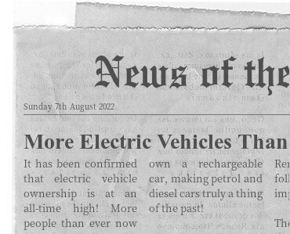
Scenario 2: electric vehicles
Alice is excited about the amount of ethically produced electric vehicles on the roads.
However, she is worried that she might not be able to afford one. Because of this, they might be stuck using their petrol vehicle which might even become more expensive to run!
What should happen next?

Slide 5
What is a 'just transition'?
As we move to low-carbon industries, we need to make sure that those whose lives depend on fossil fuels are taken care of and not forgotten about.
Pursuing a just transition is all about helping those who are most at risk when we move to low carbon ways of life and most in need of support
They may work within the fossil fuel industry
Their electricity may be generated by fossil fuels
Local fossil fuel infrastructure may pay tax which goes towards local projects
We also need to make sure that those currently without access to electricity gain access to it quickly, but not in a way that will exacerbate climate change

Slide 6
Why do we need to make sure no one is left behind?
Are the people at risk of being left behind responsible for the climate emergency?
Is it really a green transition if some people still must use or live near pollutive
industries?

Slide 7
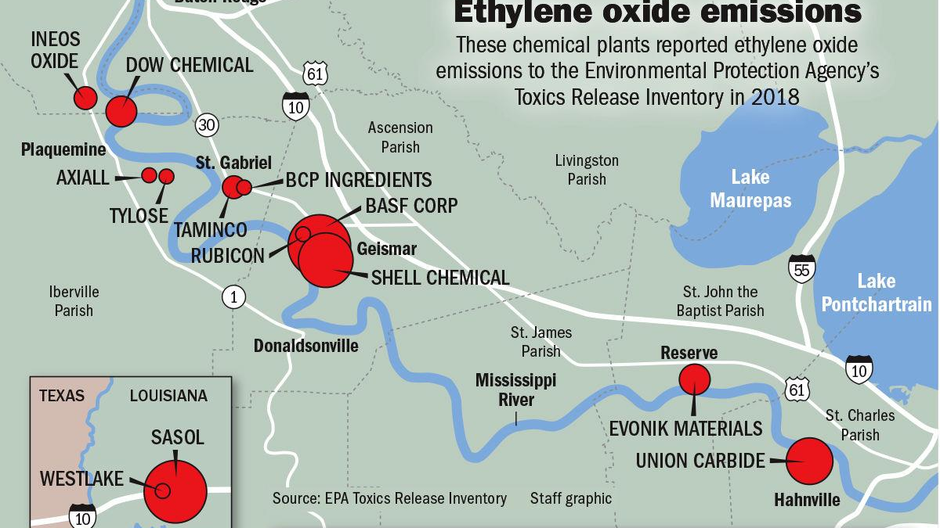
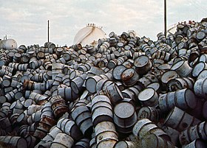
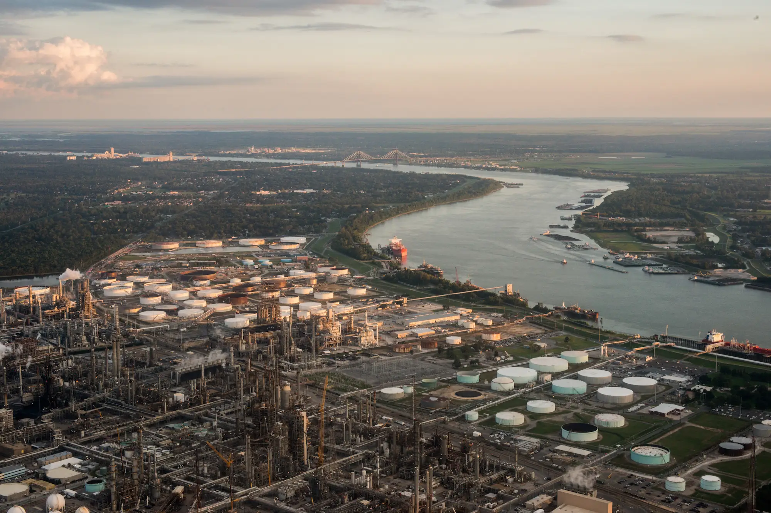
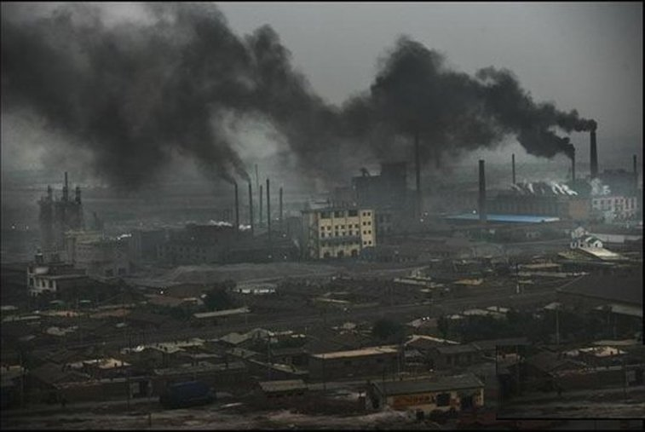
Baton Rouge – New Oreleans
'Sacrifice Zone'
46 / 1 million individuals will develop cancer (compared to the US average of 30 / 1 million)

Slide 9
If you were in charge of Tonawanda, what would you choose to replace the coal mine?
School?
Park?
Museum?
Bioenergy plant?
Shopping centre?
Something else?

Slide 10
Transitioning Tonawanda: things to consider
Will it be expensive?
Will anyone be upset by what is replacing the coal mine? What will you do to make them feel less upset?
What are the benefits of what you are proposing?
Who will benefit from it the most, will be a long-term or short-term benefit?
Whatever you decide to build must help create a just transition in Tonawanda – keep this in mind

Slide 11
What's next after fossil fuels?
Green New Deal
Green Growth
Gross National Happiness
Degrowth
Doughnut Economics
Circular Economy
Public Luxury Private Sufficiency
Buen Vivir
Business-as-Usual

Slide 12
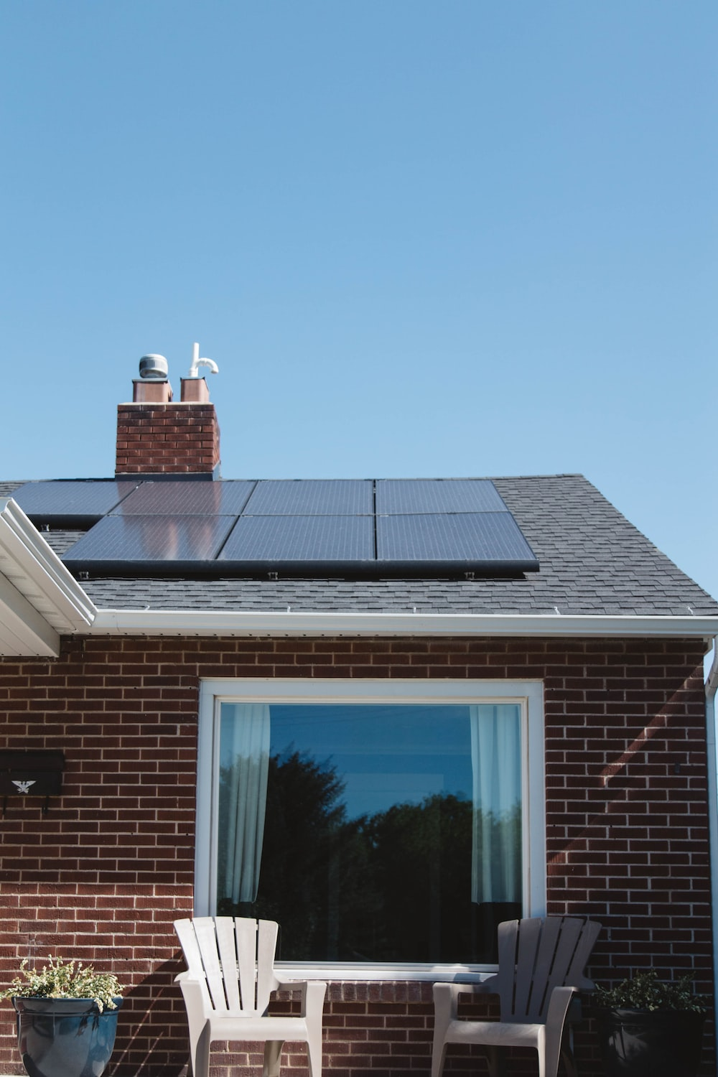
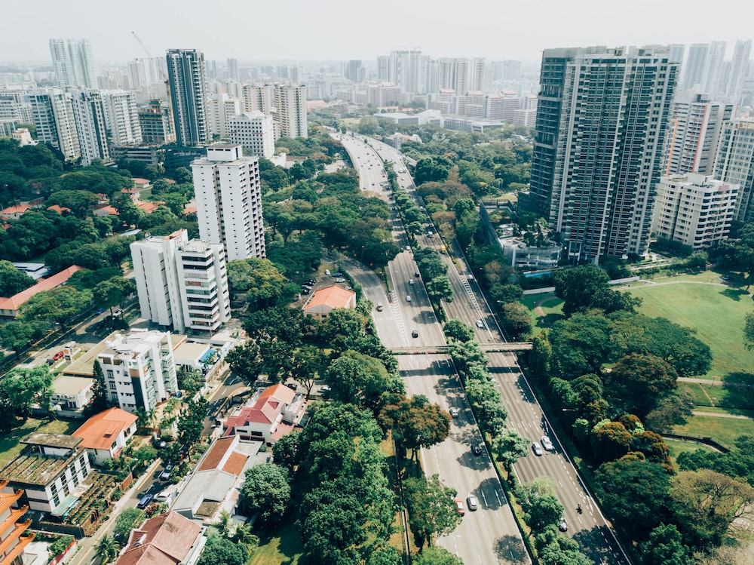
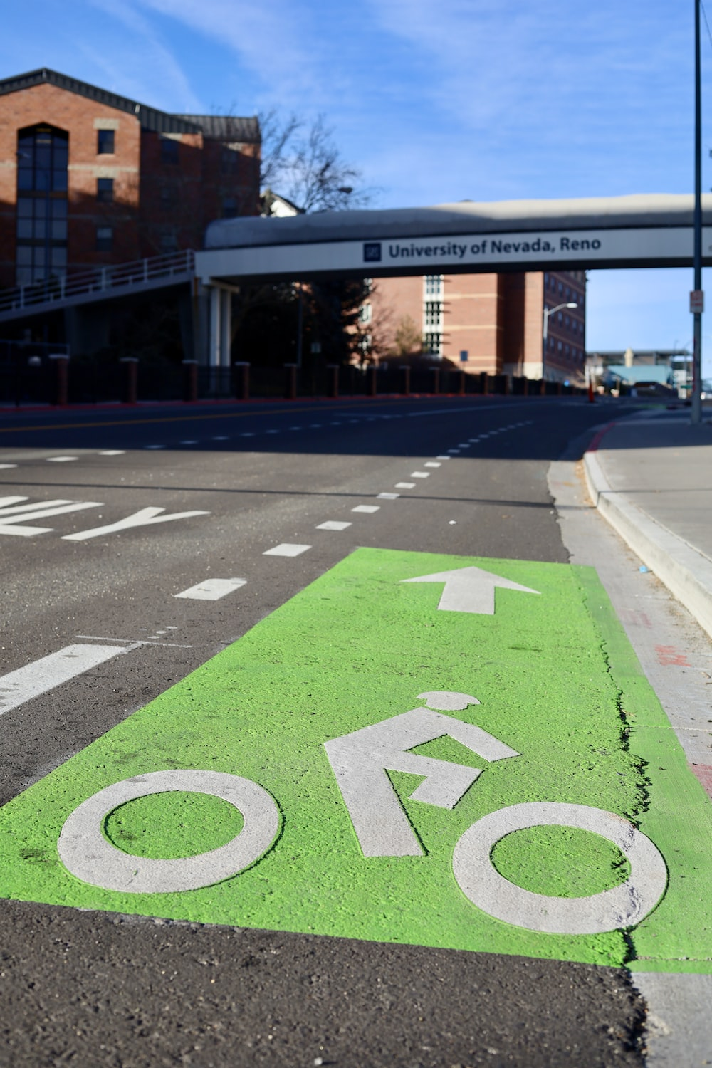
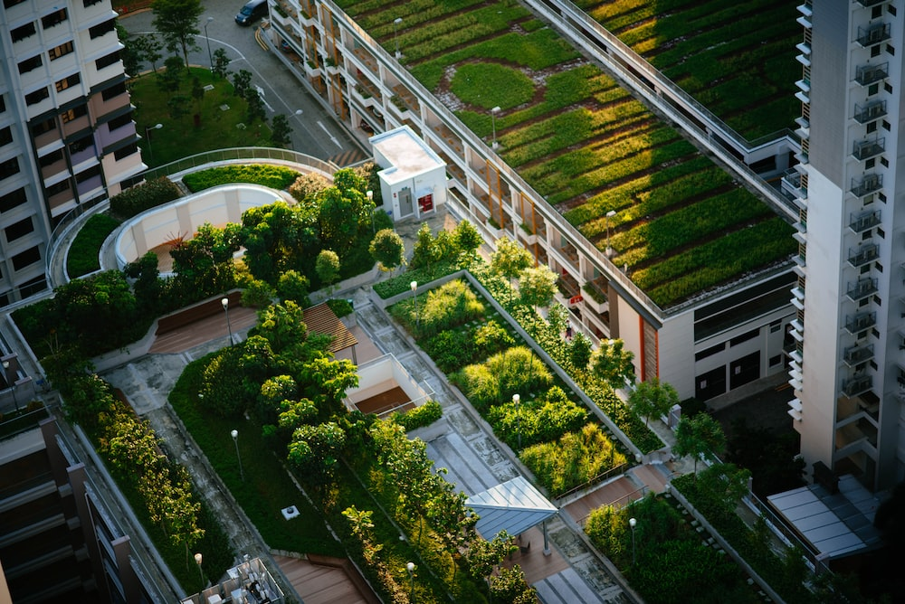
Destination 2100: we’ve solved the climate crisis – what does the world look like?
Aside from infrastructure, think about:
How are workers treated in 2100 – are their wages fair?
What do we eat? Do we still eat animals?
What jobs now exist? What jobs don’t exist?
What do we teach in schools?
Who is leading us?

