Slide 1
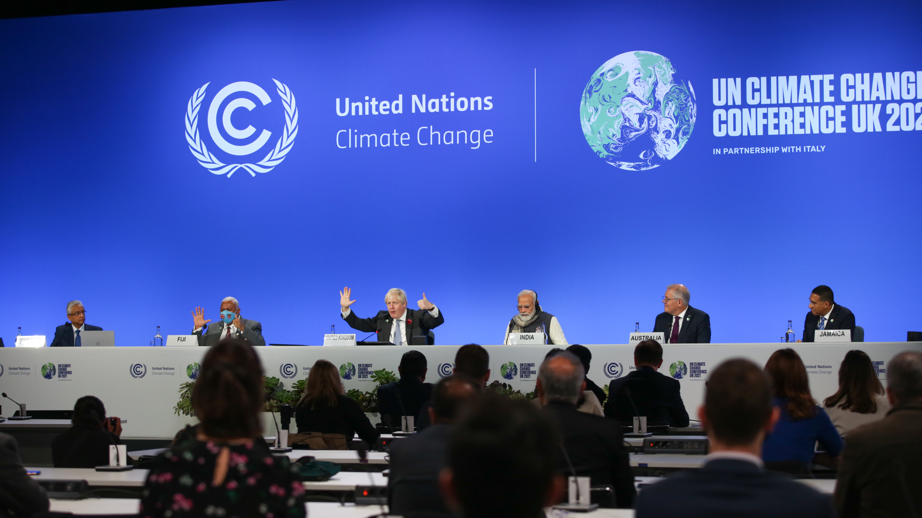
COP27 – Week 1
(featured image courtesy of the UNFCCC Flickr Page)

Slide 2
Where are we up to?
Our Learning Journey
Climate Science
Climate Justice
🗸
🗸
Sustainable Fashion
Biodiversity
🗸
The Oceans and Plastic
🗸
The Arctic
🗸
Sustainable Transport
🗸
The Importance of Collective Action
🗸
🗸
COP27

Slide 3
What are we learning today?
What is a COP?
What types of decisions are made at climate (UNFCCC) COPs?
What is the Paris Agreement and why is it so important?
What is currently happening in Egypt?
Why is it so difficult for Parties to come to agreements?

Slide 4
What is a COP?
COP stands for Conference of the Parties
Parties meet every year and discuss progress on the promises they made in previous years
Before every climate COP, there is a COY – a Conference of Youth

Slide 5
What is a 'Party'?
The UNFCCC was signed at a conference called the 'Rio Summit' or 'Earth Summit' in 1992
Why not say 'nations' or 'countries'?
While many of the Parties are also countries, the European Union (EU) signed the agreement together. As the EU is not a country, Party is used to include them.
this was held in Rio de Janeiro, Brazil!
Why not say 'nations' or 'countries'?
While many of the Parties are also countries, the European Union (EU) signed the agreement together. As the EU is not a country, Party is used to include them.

Slide 6
COPS can be on different topics
Desertification
Climate
Biodiversity

Slide 7
What is discussed at a climate COP?
Finance
Science
Youth and Future Generations
Water
Energy
Transport
Biodiversity
Gender
Adaptation
Agriculture
Indigenous rights

Slide 8
The zones at a climate COP
There are two zones at each COP: an inner blue zone and an outer green zone.
You can only enter the blue zone if you have accreditation.
Members of the public can enter the green zone and take part in all the events that are put on throughout COP!
Youth Delegates
Academics
World Leaders
Demonstrators
Academics
Anyone with accreditation
Businesses
Tourists
Academics

Slide 9
What is the Paris Agreement?

Slide 10
1.5°C and 2.0°C - what's the difference?

Slide 11
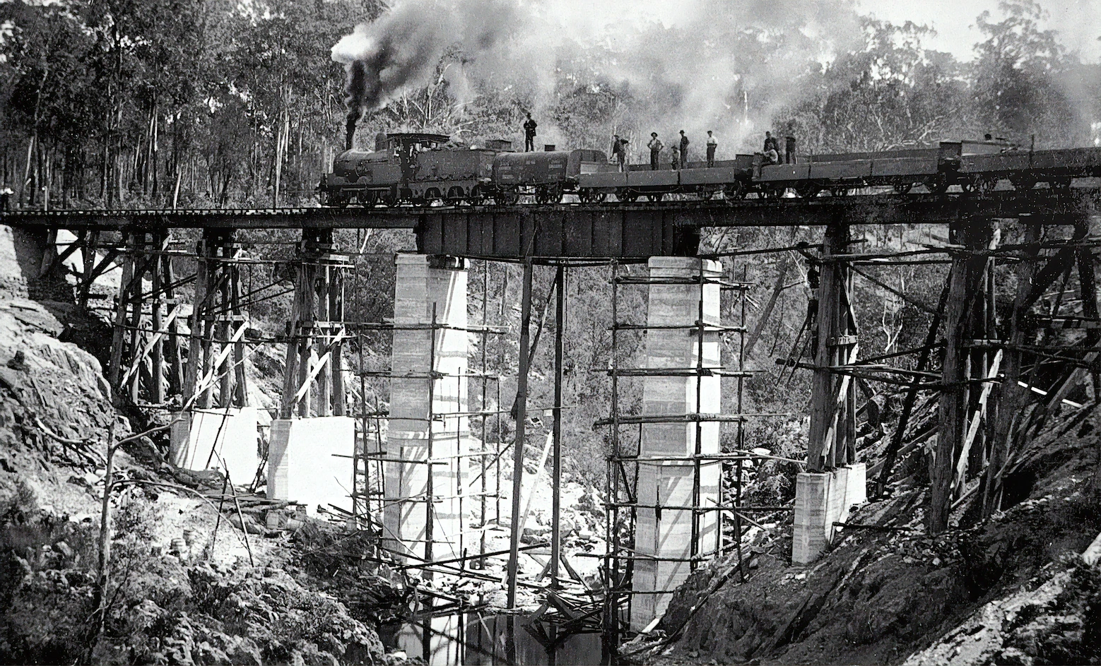
1.5°C and 2.0°C - what's the difference?
[Pre-Industrial]
[Post-Industrial]

Slide 12
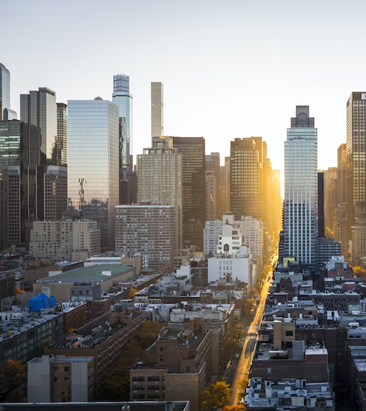
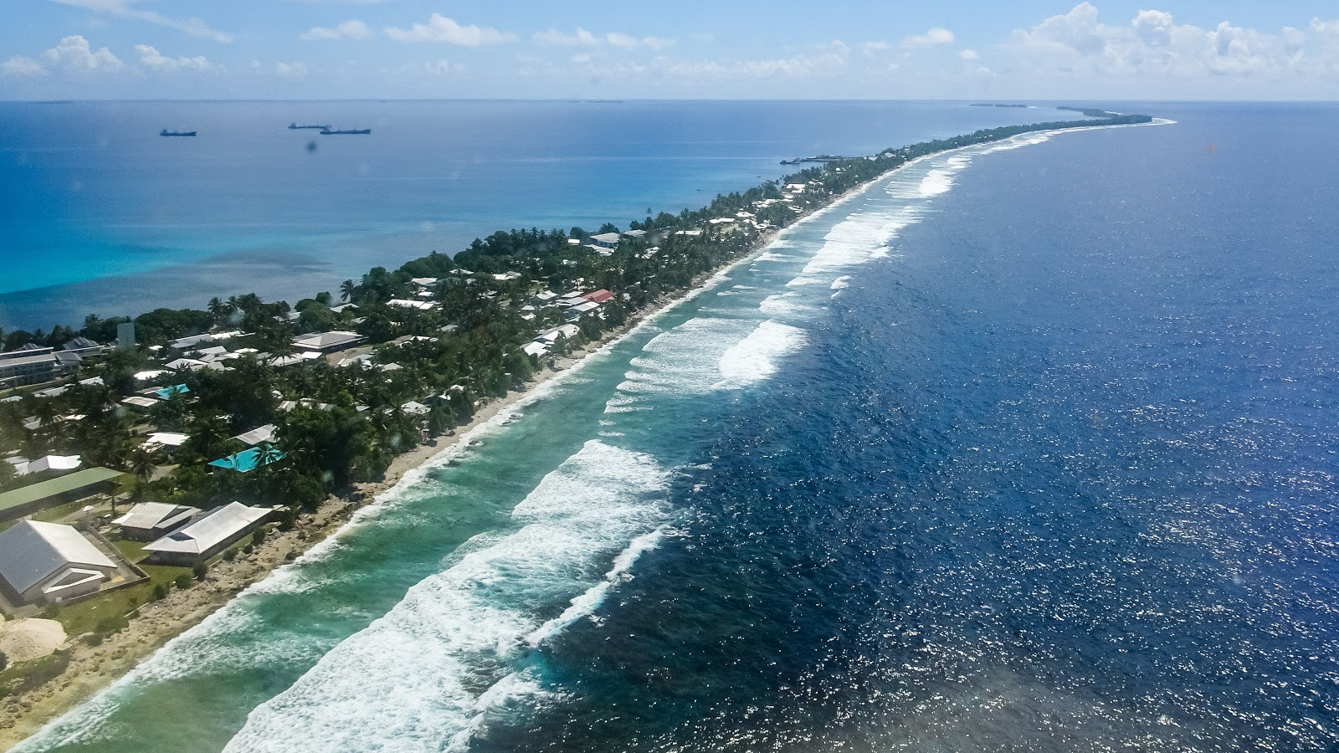
We're going to watch a video about the Paris Agreement. Pay attention to how the countries interact with each other as they begin to form the Agreement. Which countries group together? Why?

Slide 13
What is the Paris Agreement?

Slide 14
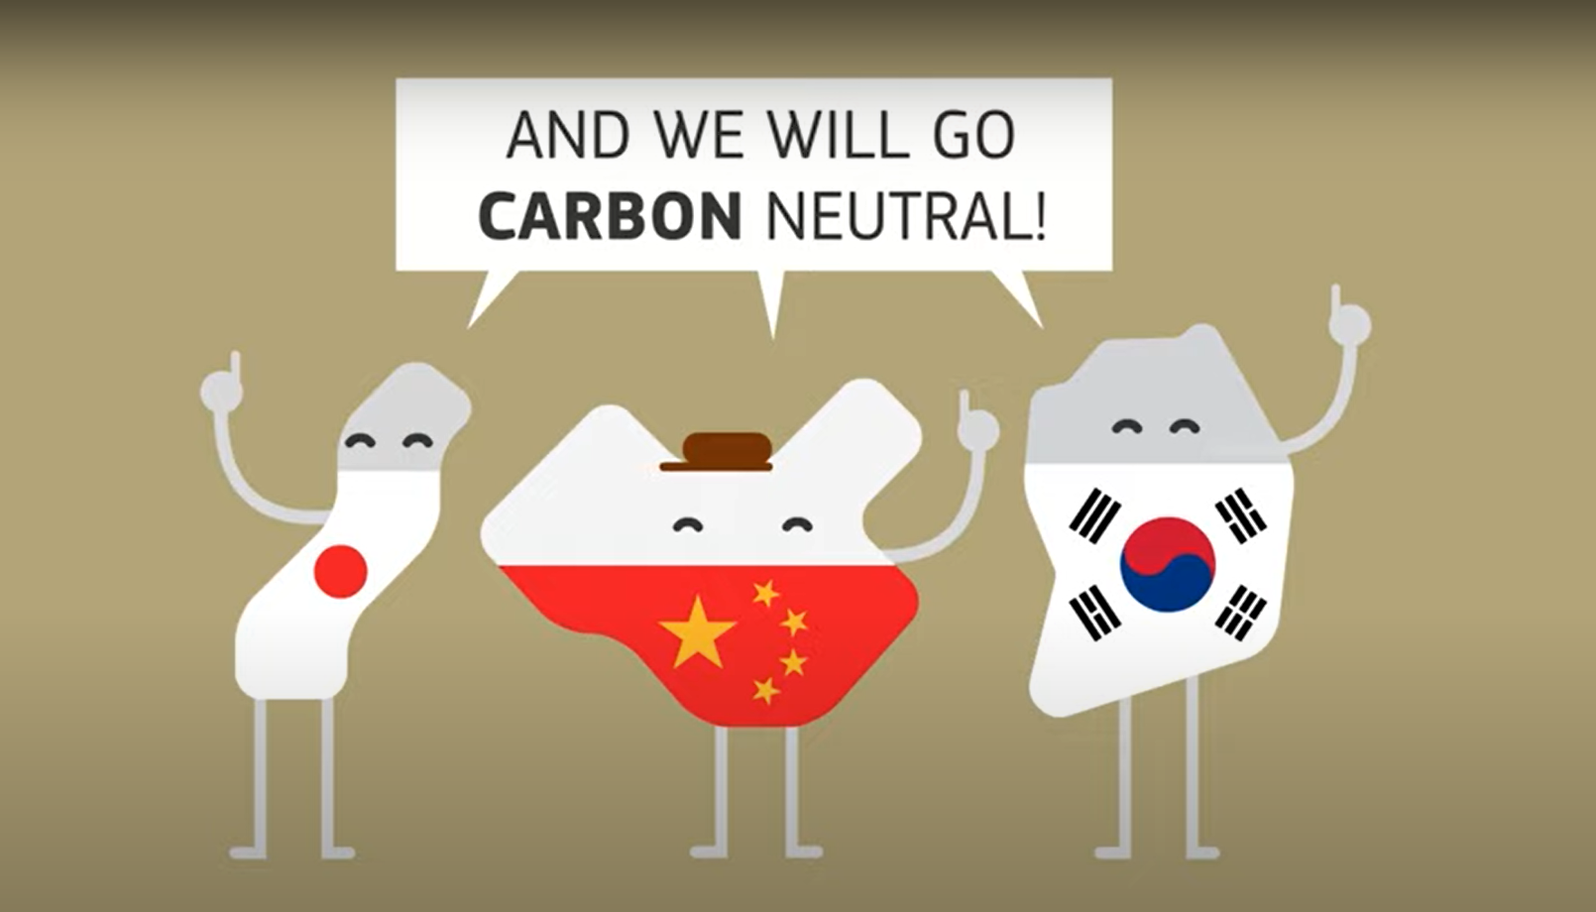
Think-Pair-Share Question 1: What do you think carbon neutral means?

Slide 15
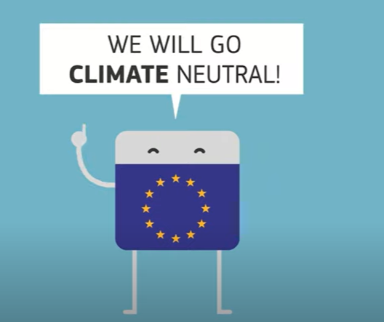
Think-Pair-Share Question 2: what do you think the difference might be between climate neutral and carbon neutral?

Slide 16
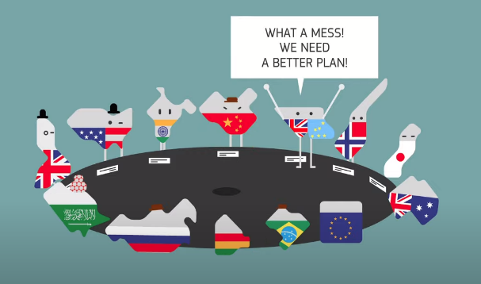
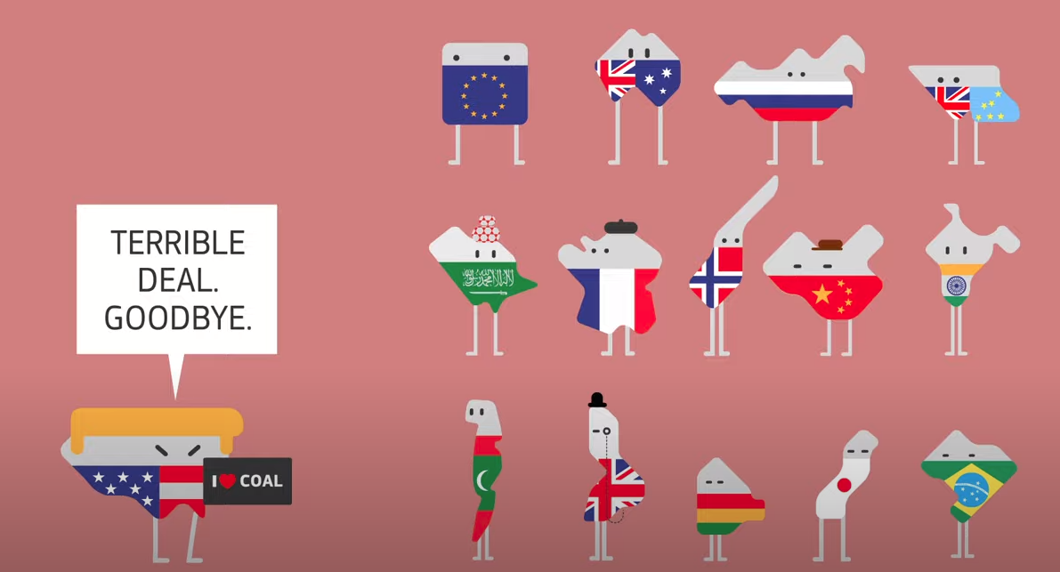
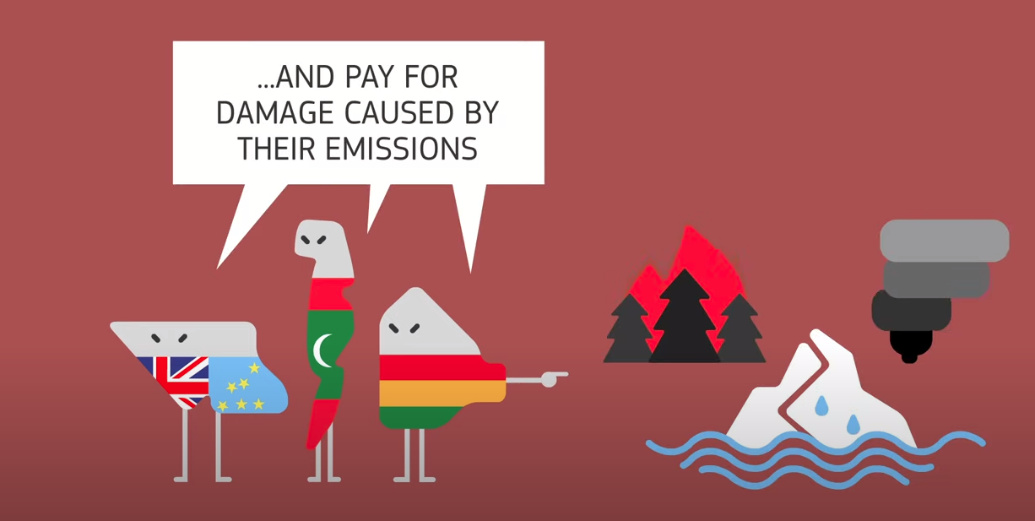
What is loss and damage?
a)
b)
c)

Slide 17
“Loss and Damage” (big L and a big D) are the plans made by Parties to address climate change impacts that cannot be avoided. These policies need someone to pay for them. Developing nations believe richer, already developed countries should pay.

Slide 18
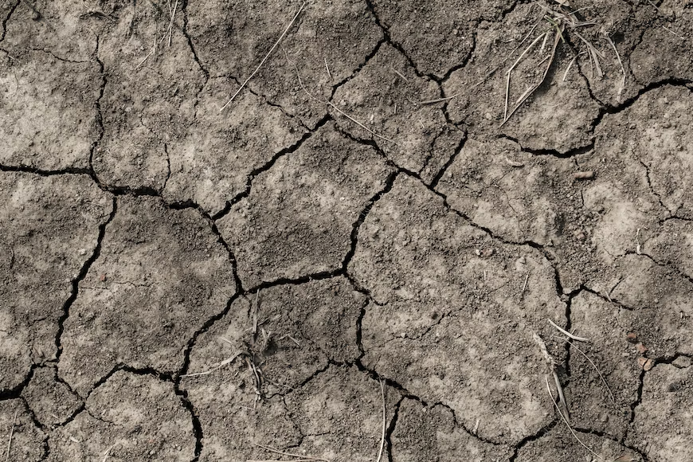
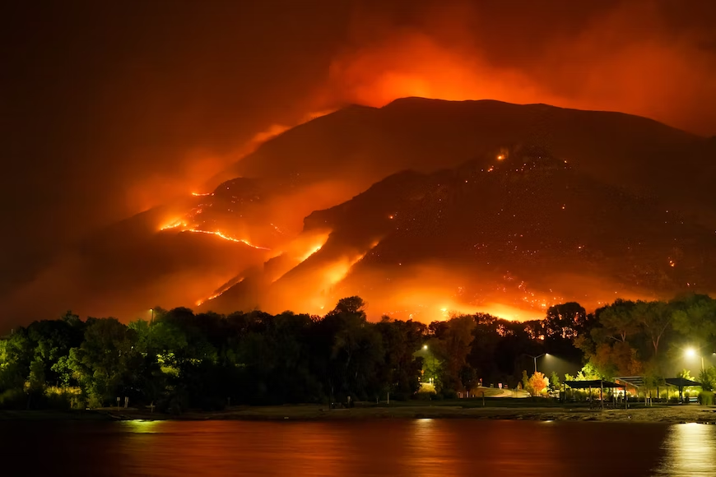
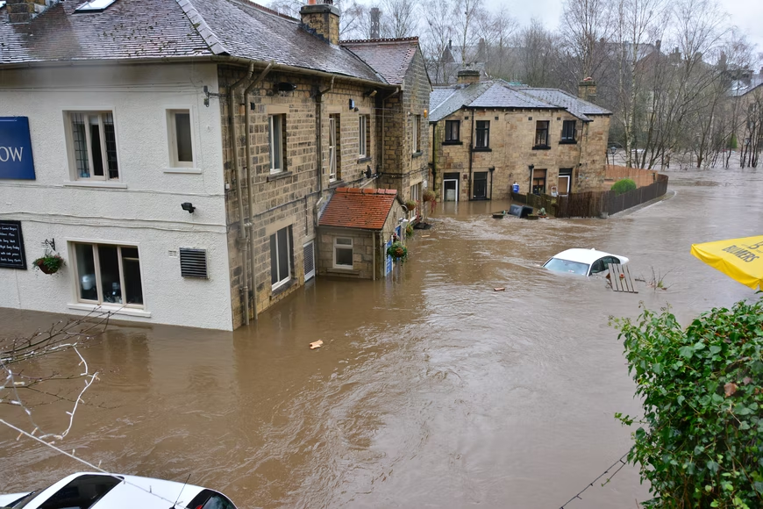
When we think of loss and damage, we think of:
Paying for losses to people's lives because of droughts, for instance.
What might people lose in such events?
Paying for damage caused by floods and wildfires, symptoms of the climate emergency.
What might be damaged in such events?

Slide 19
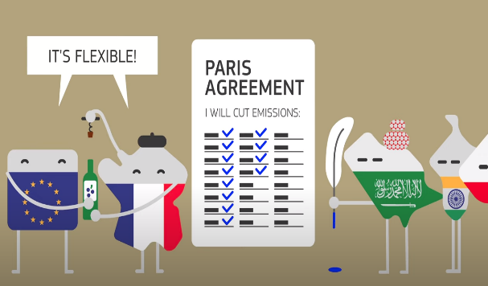
Which refers to the USA leaving the Paris Agreement?
a)
b)
c)

Slide 20
On the 4th of November 2020, the USA formally left the Paris Agreement. According to then-President Donald Trump, the Paris Agreement. In leaving the agreement, the US – as the world's second largest emitter of greenhouse gases – rescinded any responsibility it had towards the fight for 1.5C.
Do you think this was fair?

Slide 21
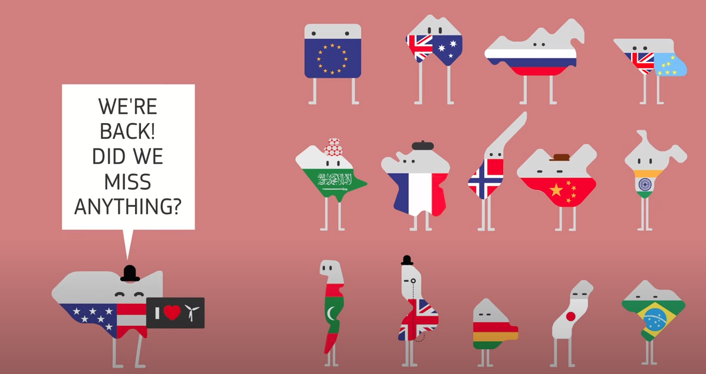
Fortunately, the USA re-entered the Paris Agreement on February 19th 2020 under the current President Joe Biden

Slide 22
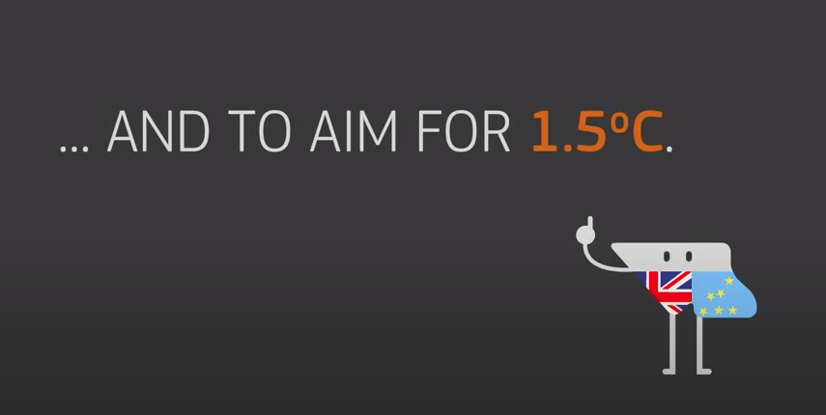
Which shows what temperature goal countries should aim to reach?
a)
b)
c)

Slide 24
Key term splat
This acronym stands for 'Conference of Parties'
UNFCCC
Party
COP
Blue Zone
loss and damage
Side Event
1.5°C
COY
Carbon Neutral
Adaptation
Paris Agreement
2°C
Loss and Damage
Climate Neutral
Mitigation
Delegate
Negotiation
Green Zone

Slide 25
Key term splat
The outer area of a COP that is open to the public
UNFCCC
Party
COP
Blue Zone
loss and damage
Side Event
1.5°C
COY
Carbon Neutral
Adaptation
Paris Agreement
2°C
Loss and Damage
Climate Neutral
Mitigation
Delegate
Negotiation
Green Zone

Slide 26
Key term splat
This term refers to how we change our behaviour or way of life to better respond to climate events
UNFCCC
Party
COP
Blue Zone
loss and damage
Side Event
1.5°C
COY
Carbon Neutral
Adaptation
Paris Agreement
2°C
Loss and Damage
Climate Neutral
Mitigation
Delegate
Negotiation
Green Zone

Slide 27
Key term splat
The things that are lost or harmed because of the climate emergency
UNFCCC
Party
COP
Blue Zone
loss and damage
Side Event
1.5°C
COY
Carbon Neutral
Adaptation
Paris Agreement
2°C
Loss and Damage
Climate Neutral
Mitigation
Delegate
Negotiation
Green Zone

Slide 28
Key term splat
The policies that address what to do about things lost or harmed because of the climate emergency
UNFCCC
Party
COP
Blue Zone
loss and damage
Side Event
1.5°C
COY
Carbon Neutral
Adaptation
Paris Agreement
2°C
Loss and Damage
Climate Neutral
Mitigation
Delegate
Negotiation
Green Zone

Slide 29
Key term splat
A conference that happens before the COP, focussing on youth
UNFCCC
Party
COP
Blue Zone
loss and damage
Side Event
1.5°C
COY
Carbon Neutral
Adaptation
Paris Agreement
2°C
Loss and Damage
Climate Neutral
Mitigation
Delegate
Negotiation
Green Zone

Slide 30
Key term splat
This initialism stands for the 'United Nations Framework Convention on Climate Change' - an agreement all Parties have signed up to.
UNFCCC
Party
COP
Blue Zone
loss and damage
Side Event
1.5°C
COY
Carbon Neutral
Adaptation
Paris Agreement
2°C
Loss and Damage
Climate Neutral
Mitigation
Delegate
Negotiation
Green Zone

Slide 31
Key term splat
The outer area of a COP that is only open to delegates, world leaders and those with accreditation
UNFCCC
Party
COP
Blue Zone
loss and damage
Side Event
1.5°C
COY
Carbon Neutral
Adaptation
Paris Agreement
2°C
Loss and Damage
Climate Neutral
Mitigation
Delegate
Negotiation
Green Zone

Slide 32
Key term splat
According to the Paris Agreement, all countries should aim to limit global warming to this temperature above pre-industrial levels
UNFCCC
Party
COP
Blue Zone
loss and damage
Side Event
1.5°C
COY
Carbon Neutral
Adaptation
Paris Agreement
2°C
Loss and Damage
Climate Neutral
Mitigation
Delegate
Negotiation
Green Zone

Slide 33
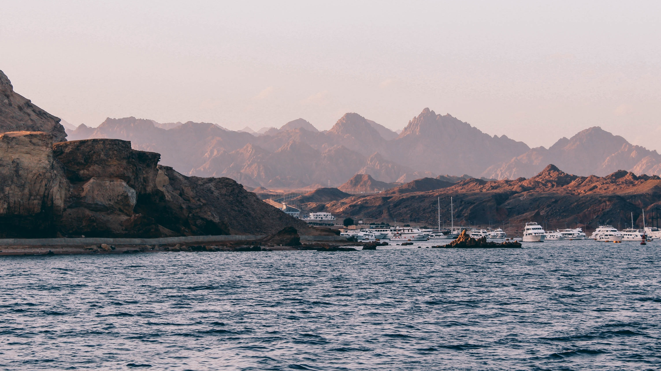
COP27 is currently taking place in Sharm El-Sheikh in Egypt

Slide 34
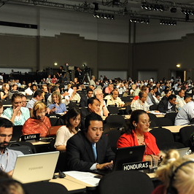
Your task: plot the history of the climate COP
Using the Atlases, plot where the previous and upcoming COPs have been or will be
Which continents have hosted the most? Do you think certain continents should host more? Why?
(featured image courtesy of the UNFCCC Flickr Page)

