Slide 1
Sustainable Transport

Slide 2
What are we learning today?
Why is sustainable transport needed?
What types of sustainable transport already exist?
What does the future look like for sustainable travel?
What are some problems with different modes of sustainable travel?

Slide 3
How did you get to school today?

Slide 4
Results
What was the most popular mode of transport? Why?
Were there any modes of transport not taken? Why?
Do you think the same thing would happen in a different area? Why?

Slide 5
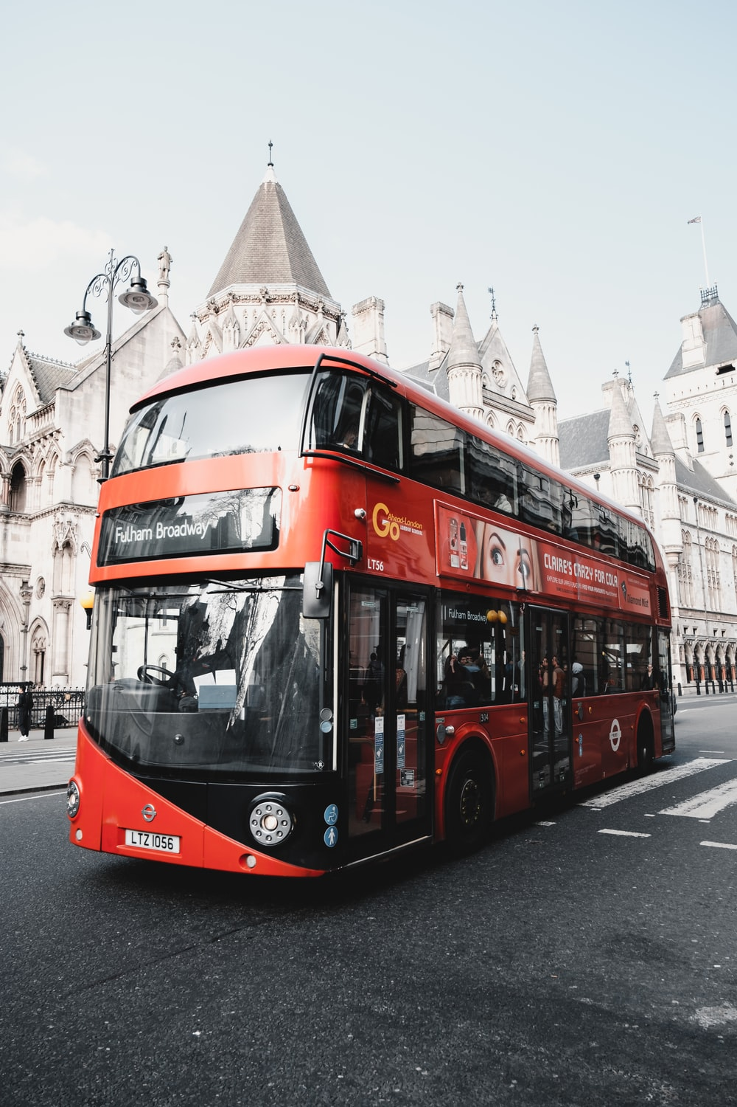
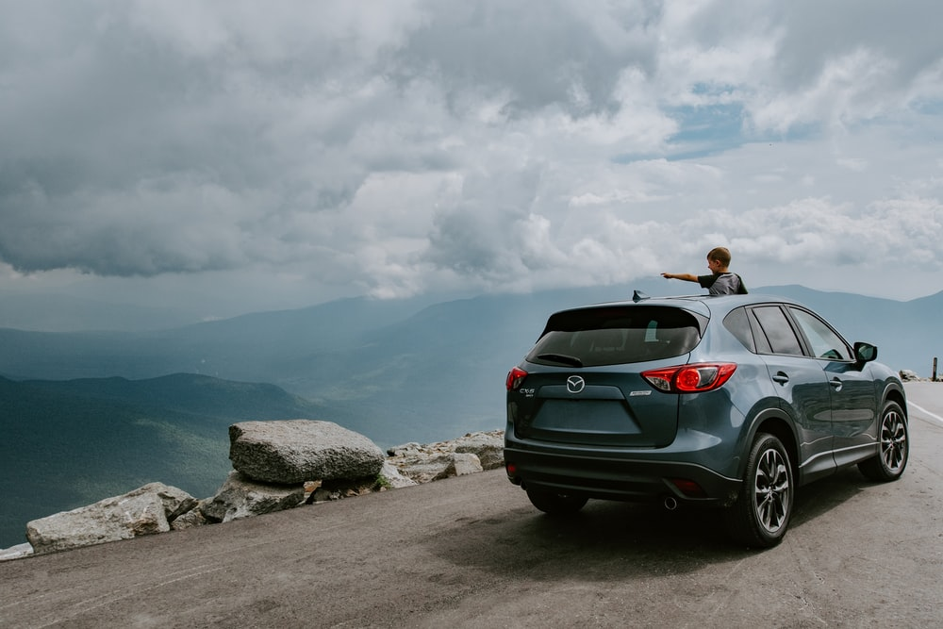
Group these modes of transport into low, medium and high emissions

Slide 6
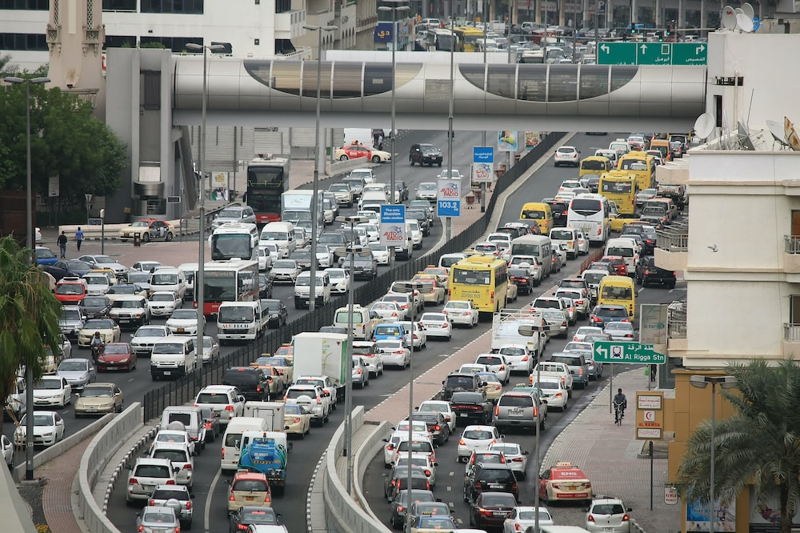
Where might you see traffic jams?
Is there a more efficient, green alternative?
Who is affected by traffic jams like this?

Slide 7
Why might people prefer to drive their own car?
Make public transport reliable
Make public transport
accessible
More convenient than waiting for public transport
Require special assistance that public transport might not provide
Make sure all areas are connected to public transport
There might be no public transport provisions where they live

Slide 8
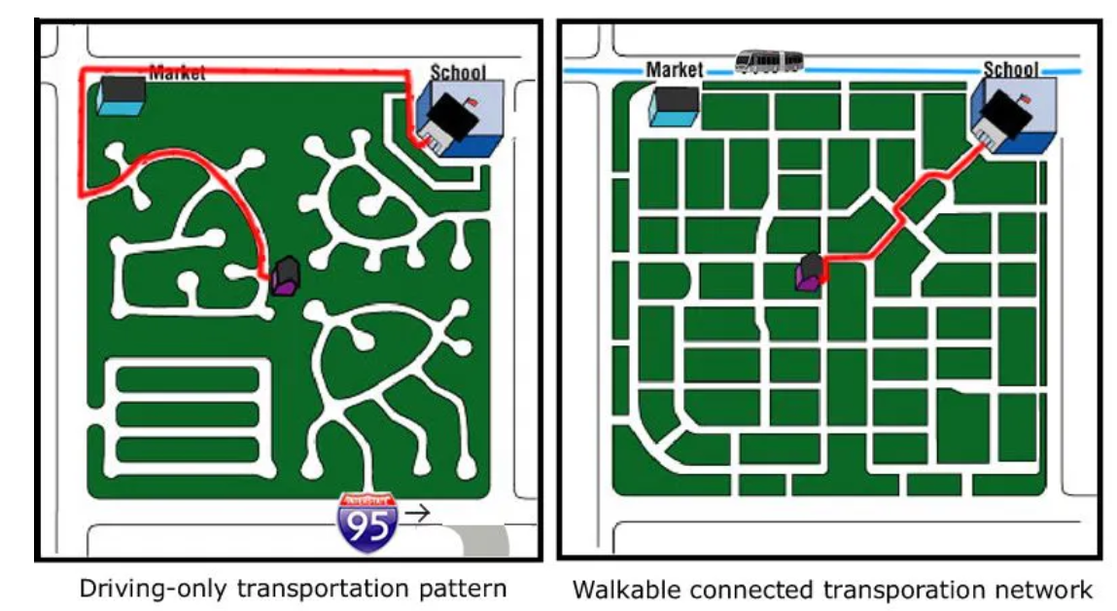

Slide 9
Electric vehicles
Electric vehicles offer an alternative to regular cars.
They emit fewer greenhouse gas (GHG) emissions than regular cars.
However, they require charging and other materials that regular cars do not.
Notes:
Graph Source (Electric vehicle market statistics 2022 - How many electric cars in UK ? (nextgreencar.com))

Slide 10
What is needed to power electric vehicles?
Batteries
Charging points

Slide 11
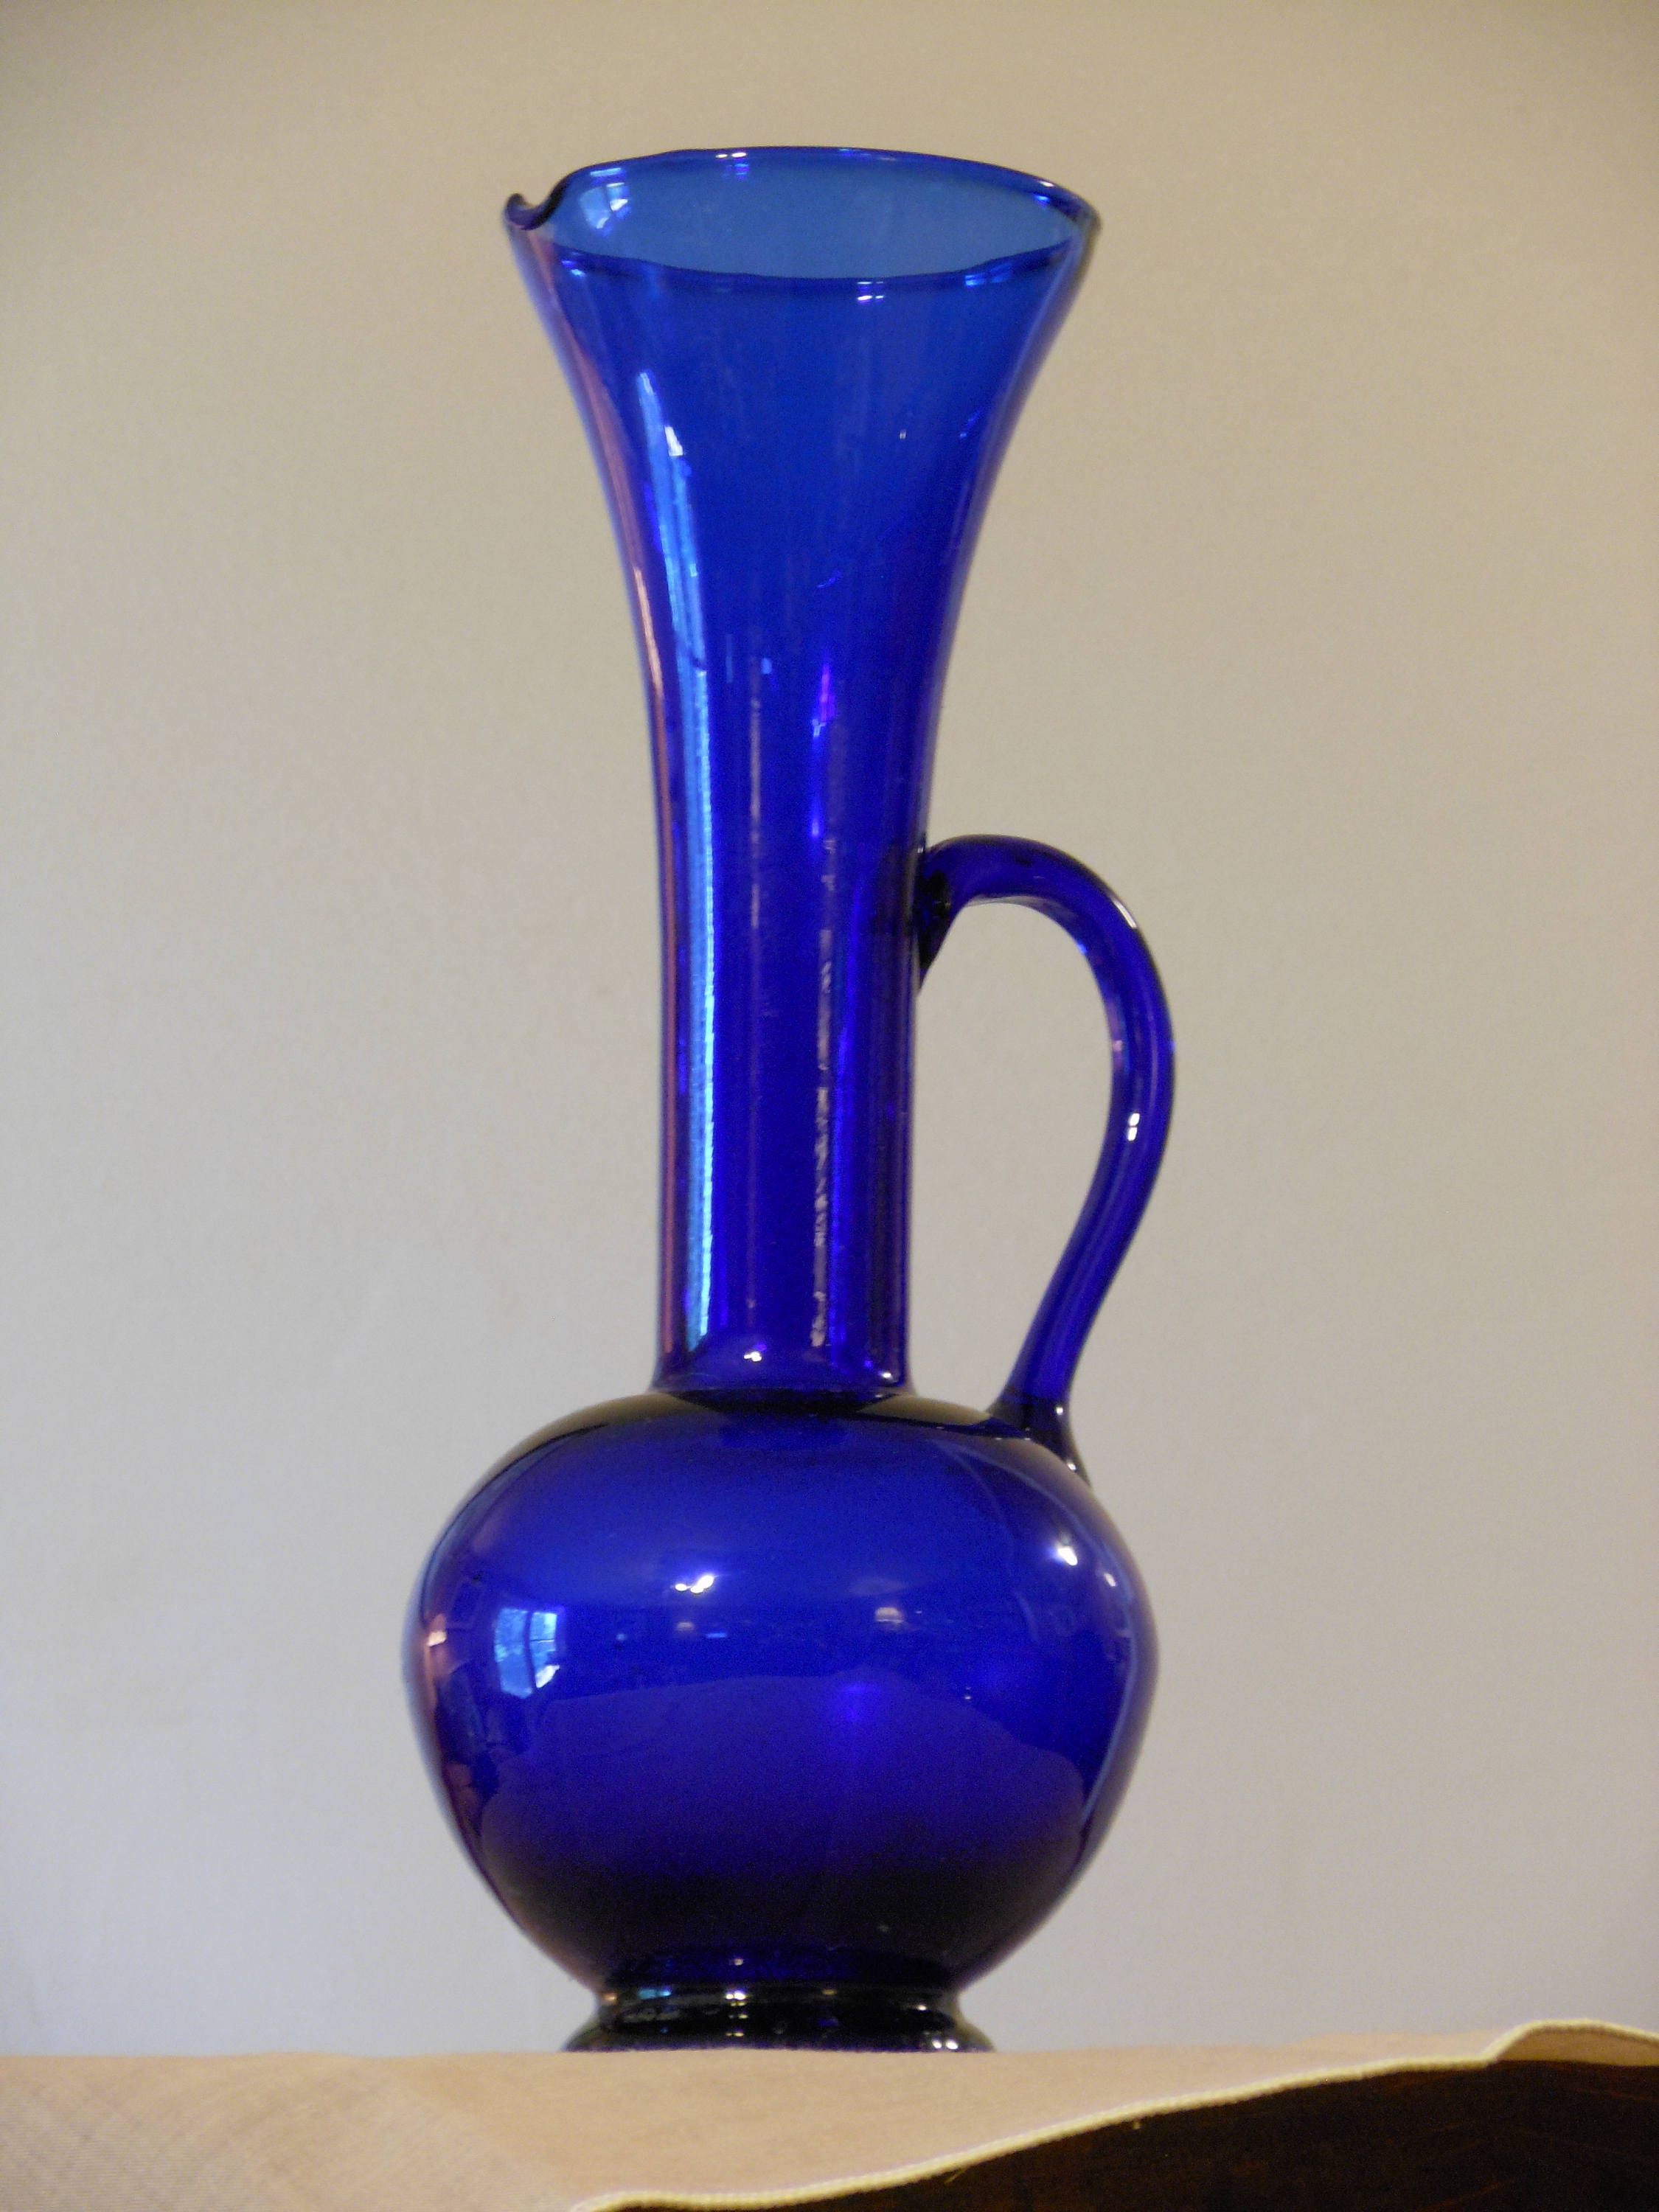
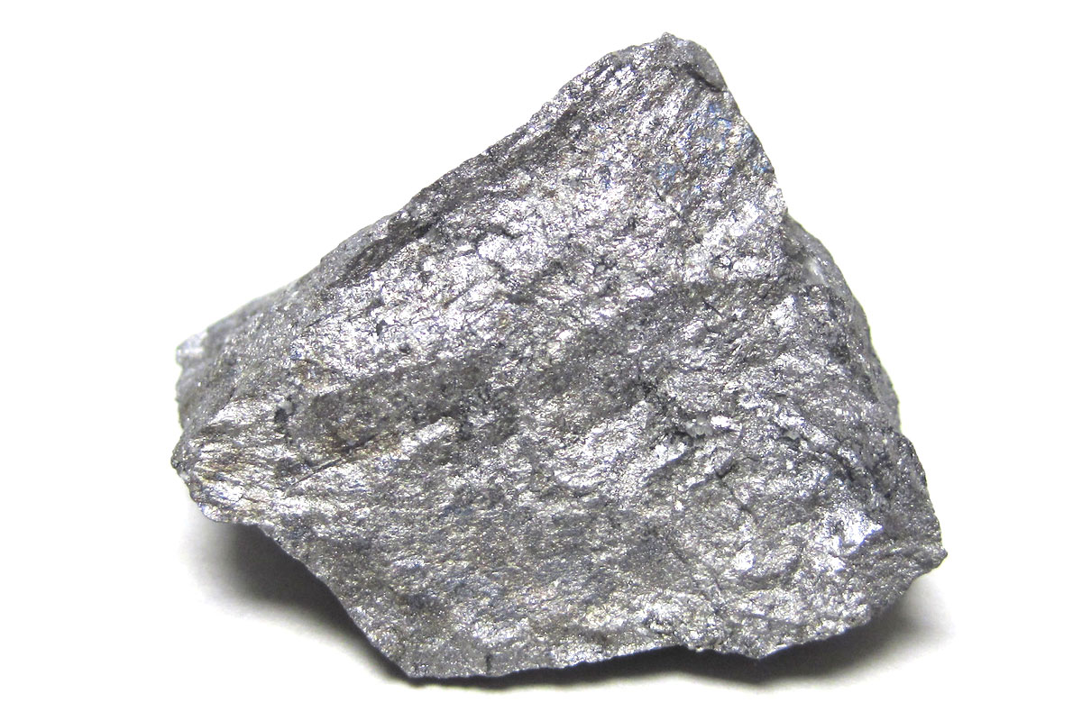
Why is cobalt so important?

Slide 12
Why is cobalt so important?
Allows electric cars to travel long distances
Stops electric cars from overheating (and exploding!)
Its location (?)

Slide 13
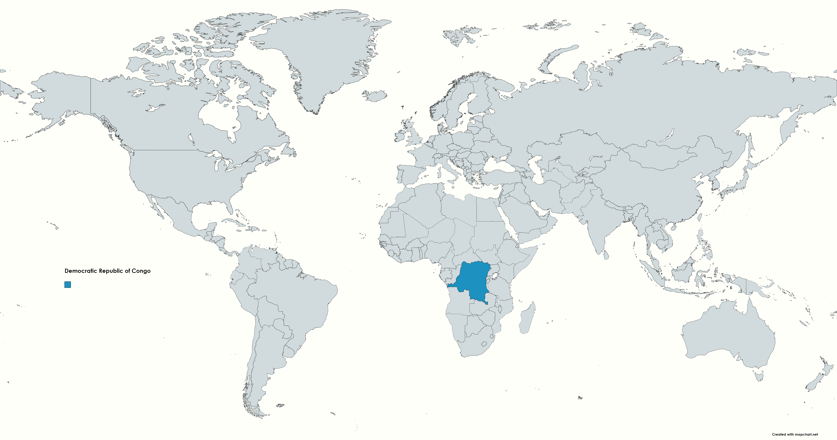
Democratic Republic of Congo (DRC)

Slide 14
Cobalt is a non-renewable resource!
What does ‘non-renewable’ mean?

Slide 15
The Democratic Republic of Congo
Cobalt
Copper
Gold
Timber
Diamonds
Coltan
Tin Ore
Oil
The DRC is thought to hold more than 50% of the world’s cobalt

Slide 16
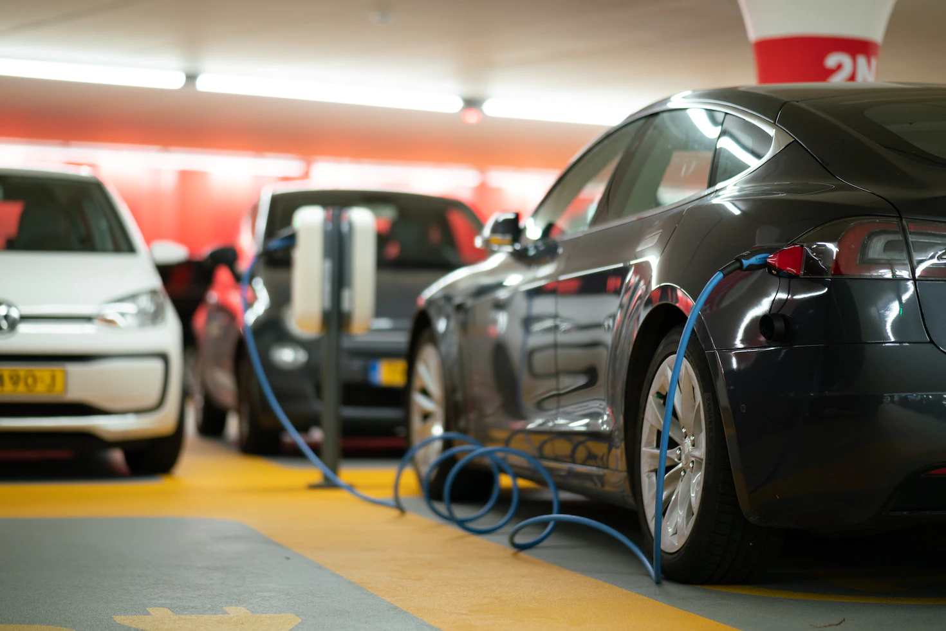
While EVs can be better for the environment, we must look at how they are made

Slide 17
Cobalt mining in the DRC
Children are often forced to mine to generate an additional income for their families
Local people are not allowed to use their land for farming and water collection – mining for cobalt comes first
Do you think this is fair? Why (not)? What do we do about Electric Vehicles?

